Slide 1
Was Tarzan a Three-bandage man?
By Bill Cosby

Slide 2
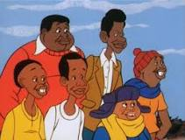
Background Knowledge
William Henry "Bill" Cosby Jr.
an American comedian, actor, author, television producer, educator, musician and activist.
He starred in his own sitcom, The Bill Cosby Show.
And he created the educational cartoon comedy series Fat Albert and the Cosby Kids, about a group of young friends growing up in the city. Cosby also acted in a number of films.

Slide 3
Background Knowledge
During the 1980s, Cosby produced and starred in one of the decade's defining sitcoms, The Cosby Show, which aired eight seasons from 1984 to 1992. It was the number one show in America for five straight years (1985–89). The sitcom highlighted the experiences and growth of an affluent African-American family.

Slide 4
Background Knowledge
MORE RECENTLY:
In 2002, scholar Molefi Kete Asante included him in his book The 100 Greatest African Americans.
In 1976, Cosby earned a Doctor of Education degree from the University of Massachusetts Amherst. His dissertation discussed the use of Fat Albert and the Cosby Kids as a teaching tool in elementary schools.

Slide 5
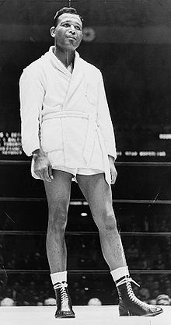
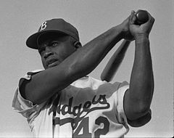
Who are they?
Jackie Robinson:
1st African American to play in Major League Baseball
Sugar Ray Robinson:
A very successful, professional boxer.

Slide 6
Admiration
Many young and old copy others as a sign of admiration.
This persuades them how to dress or act. Even what to say.
What have you imitated?
Who persuaded you to talk or act or dress or etc. in that way?

Slide 7
REDDISH COSMETIC USED TO COLOR CHEEKS | MAKING A SOUND LIKE A PROLONGED S | DEJECTEDLY | TIERED | FORM INTO LEGAL BUSINESS
SADLY | STACKED IN ROWS | X Sorry, this card doesn’t have a match. | TOURNIQUETS | ROUGE
DEJECTEDLY | BANDAGES TIGHTLY TWISTED TO STOP THE BLEEDING | HISSING | INCORPORATE | SADLY
Return
Return
Return
Return
Return
Remove
Remove
Remove
Remove
Remove
Return
Return
Return
Return
Return
Remove
Remove
Remove
Remove
Remove
Return
Return
Return
Return
Return
Remove
Remove
Remove
Remove
Remove

Slide 8
1st. Write at least two things Bill and his friends did to imitate their sport idols. 2nd.Turn to Page 88- Do all of the ‘Vocabulary Development Lesson’ section

