Slide 1
The Life Of Nyla Ivy
Period 7
And my family

Slide 2
I am from speakers
playing my favorite songs
from game day jerseys to football gear
I am from dirty clothes
behind the bathroom
door and children's giggles
out of my room window

Slide 3
I am from the clovers and
daisy's in the front yard
whose long gone limbs I
remember as if they
were my own

Slide 4
I am from water hose sparing
And shopping cart
rides down hill
From Mustapha and Angel
I’m from cigarettes on
the front porch
And laughs in the living room

Slide 5
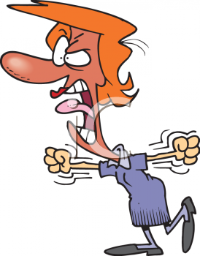
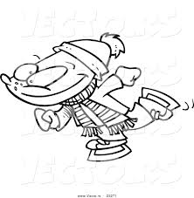
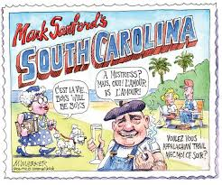
I’m from clean your room
And your on thin ice
And do the potty dance
I’m from photo shoots
I’m from Vallejo and down
south

Slide 6
Baked beans and dirty rice
From the story’s I love
That always start with
“back in the day”
Poetic justice brads
And nappy headed
Cousins and Aunts

Slide 7

Under my bed besides
The monsters and goblins
That scared me at night
Is a passed down bible
loose papers and clothes
And my dog lies under
Protecting me

Slide 8
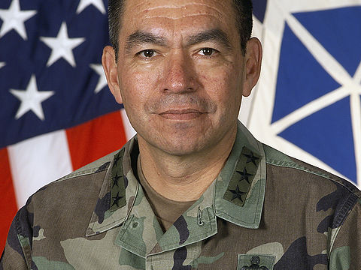
Ricardo Sanchez
I’m from war and military scares and los lobos & El Chicano
I’m from the strength of my father I’m from El Paso, Texas and new Mexico
Espinacos and arroz con pollo from the love of my community

