Slide 1
Tenzin Tsephel
7th period
About my life

Slide 2
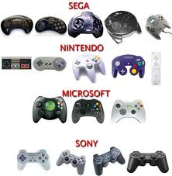
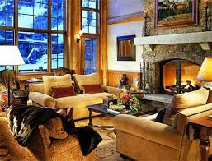
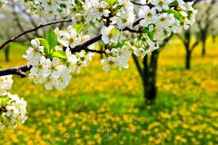
I am from video games from T.V and IPod. I am from warm and safe place. I am from flower. The tree whose long limbs I remember as if they were my own.

Slide 3
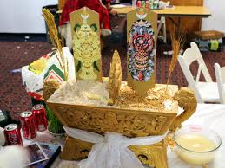
I am from New Year and Himalian fair from Lobsang Chodon and Tenpa Tsering. I am from praying in the morning and from eating dinner together.

Slide 4
I am from “that my parents had to work hard when they were small” and small money maker and I will work hard. I am from “Losar.” I am from India and Tibet. I am from “that my parents work hard for money when they were small.

Slide 5
In my heart.
From Tenzin Tsephel.

Slide 6
Akayah burmbra
I am from New York and I use to celebrate to help the poor and immigrant from Europe and I listen to the riddles. I am from denial doranda. I am from new york and Portugal. Gelfite fish and cinnamon vanilla.
From Jorge Dlio,Danial,Dorando,Moses Lazarus, and Ester Nathen.

