Slide 1
Where I’m From …
Ricardo Velasco
Period 7th

Slide 2
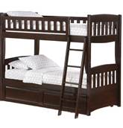
I am from television, bunk bed, and stuffed animals I am from the 5 bedrooms that smell like roses I am from the sunflower The lemon tree whose long gone limbs I remember as if they were my own.

Slide 3
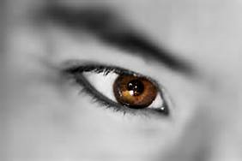
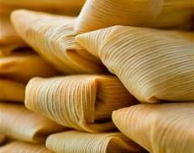
I’m from training the kids and brown eyes from Gabriela and Saul I’m from watching the boxing and making tamales and from training the kids.

Slide 4
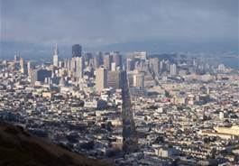
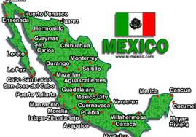
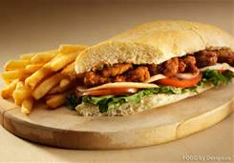
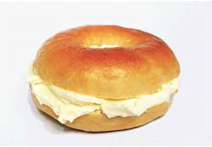
I’m from clean your room and do your homework and Can’t Hold Us the song I’m from training the kids I’m from San Francisco and Mexico Sandwiches and bagels From my mom’s life Josue fighting Danny at Double Punches Boxing Club.

Slide 5
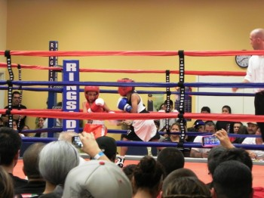
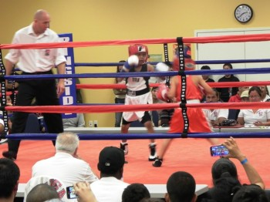
In my heart, I saw Josue fought Danny for the 5th time My brother won for the 2nd time against Danny My whole family was very proud.

