Slide 1
Where I’m from
By: parion roberts
period 7

Slide 2
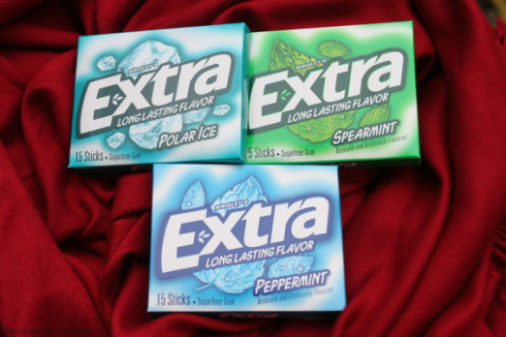
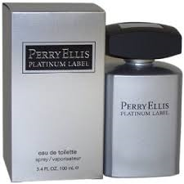
I am from a piece of gum from a flatscreen TV and Perry
Ellis . I am from the middle bedroom in my house , a small
jacuzzi in the back . I am from birds in the sky . The big
green tall trees , whose long
Limbs I remember as if they
were my own .

Slide 3
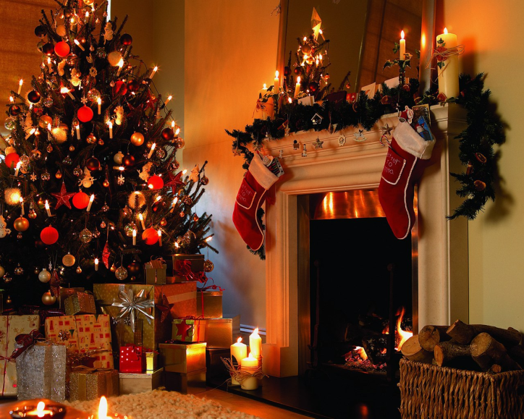
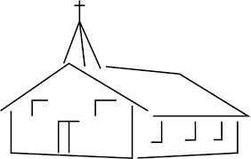
I’m from movies on Sunday evening and opening 1 Christmas gift on Christmas Eve , from Markela and Willie Jr. . I’m from chewing gum and watching American Idol and from going to Church.

Slide 4
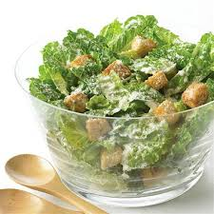
I’m from never give up and take out the trash and silent night . I’m from opening gifts on Christmas Eve . I’m from San Pablo and around the U.S. , Ceaser salads and chicken . From “Ms. Nelson Is Missing “; a new teacher comes the old teacher goes, a small family with love for one another .

Slide 5
A big cardboard box under my bed .
A big family photo album .

Slide 6
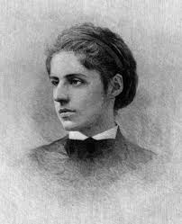
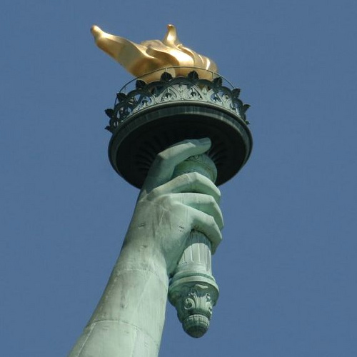
The new colossus by: emma lazarus
I’m from New York City and a mighty woman with a torch and
Rapunzel. I’m from Daniel Doranda . I’m from the Big Apple
and Portugal , bagel and caramel custard; from George
Eliot , a wealthy family of 7
Moses Lazarus .

