Slide 1
Our Culture
By Nikhil Masand , Emma Blenkinsop, Noah Hattevik, and Hannah-Lane Goldstein

Slide 2
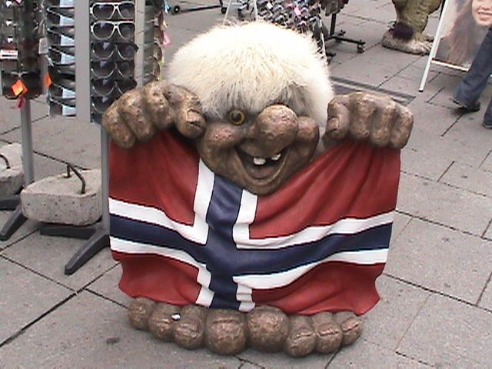
All Star Culture
Noah
My culture is from a Norwegian background. Norway is a cold country in Europe, although it is warm in the summer. Norway is also a part of Scandinavia. The Scandinavian countries are Norway, Sweden, Denmark, and Finland.
Norwegians are very wealthy people and have a high class way of living. Norwegians have one of the safest environments in the world. With this combination, I think Norwegians have a relaxed and positive way of living.

Slide 3
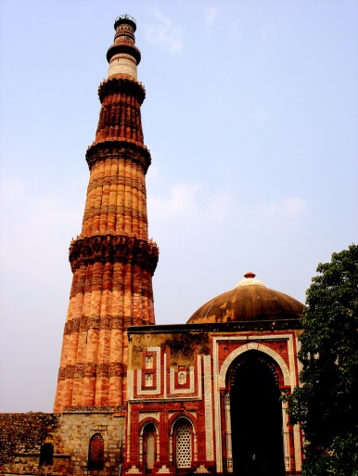
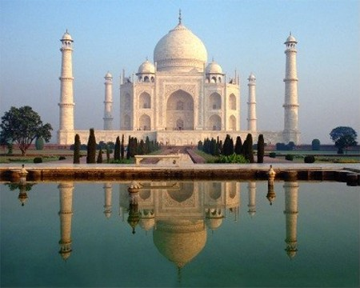
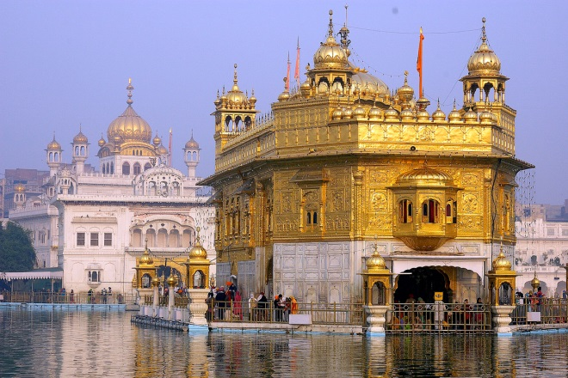
Nikhil
My culture is from a Indian background. There are many holidays and celebrations that Indians celebrate. Some holidays include – Holi (pronounced Holy) and Lohri (pronounced Lory).
Holi is the celebration of Color. In this festival people go around spray people with Color dye powder . This year Holi took place on Monday, March 17.
Lohri is celebrating the harvest of India. During this time people come out and harvest the new crop. Why I think the holiday Lori is so special? I feel this holiday is special because it is on my birthday, January 13.
Taj Mahal
Golden Temple
Qutub Minar

Slide 4
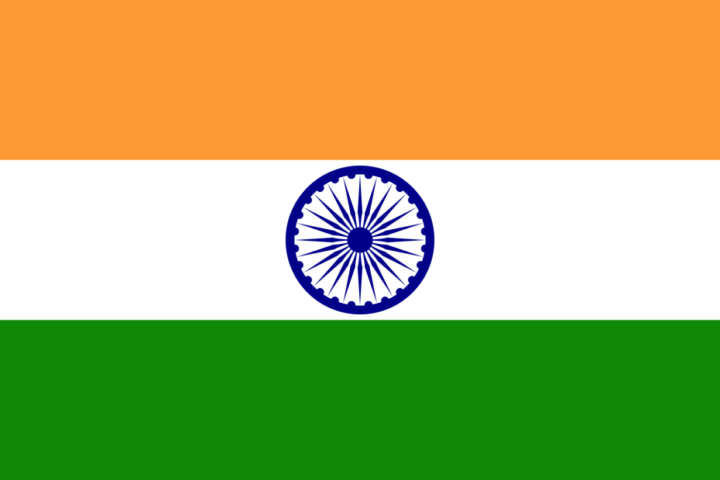
Meaning of Indian flag colors
Flag of India
The saffron (orange) represents the courage and
Sacrifice. It is also the color pious people wore.
The white color represents unity, peace, and truth. The green symbolizes culture and fertility. Lastly, the blue circle represents the sky and the Ashok Chakra, the chakra has 24 spokes representing 24 virtues to live a harmonious life.
Meaning of flag colors
Meaning of flag colors
Meaning of flag colors
The orange or saffron represents the courage and
sacrifice that India had also the color saints wore. The middle white color represents unity, peace, and truth. The green color symbolizes culture and fertility. Lastly, the blue circle represents the sky and the ocean Chakra, the chakra has 24 spokes representing 24 hours in a day.
The orange or saffron represents the courage and
sacrifice that India had also the color saints wore. The middle white color represents unity, peace, and truth. The green color symbolizes culture and fertility. Lastly, the blue circle represents the sky and the ocean Chakra, the chakra has 24 spokes representing 24 hours in a day.
The orange or saffron represents the courage and
sacrifice that India had also the color saints wore. The middle white color represents unity, peace, and truth. The green color symbolizes culture and fertility. Lastly, the blue circle represents the sky and the ocean Chakra, the chakra has 24 spokes representing 24 hours in a day.

Slide 5
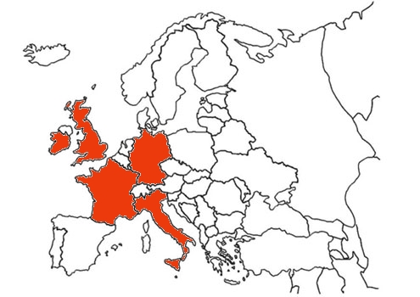
Emma
My family is from a variety of cultures in Europe. My mother’s family comes from Italy and Ireland. My father’s also comes from Ireland, along with France, Germany, and England.
However, both sides of my family have been in America for generations. Although my ancestors may have come from Europe, I am first and foremost an American.

Slide 6
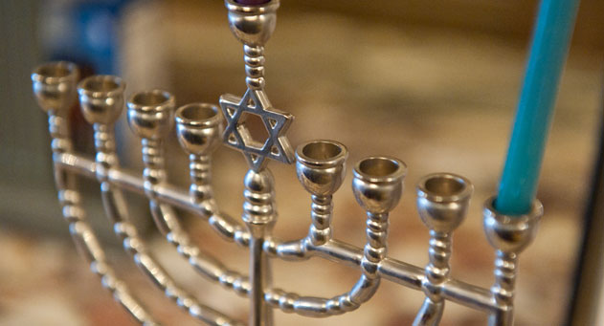
Hannah
My family is from eastern Europe, especially Poland and Russia; but when the Holocaust struck my ancestors moved to New York in the borough of Brooklyn.
We celebrate Jewish holidays such as Hanukkah, Passover, Sabbath, Yom Kippur, and Rosh Hashanah. Everything my family does is part of my religion and culture today.

Slide 7
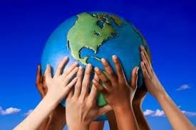
Conclusion
All of us come from different backgrounds, like all of the people in America. Together, the different cultures of our nation form a diverse, varied, melting pot of people.

