Slide 1
Our Culture
By:
Nandita Khadgi
Litzy Lule
Mela Seyoum
Arianna Rodriguez

Slide 2
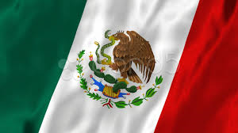
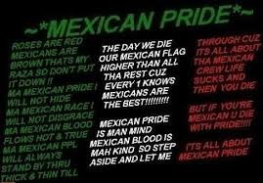
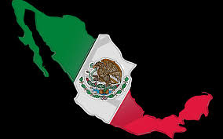
Mexican Culture
In Mexico, we earned our independence on September 16,1810. Mexicans are hardworking people, we never give up ,that’s one of our qualities. Our culture is very cheerful and full of energy. We wear sombreros and colorful dresses to celebrate our independence, special parties , and town celebrations. Cinco de Mayo, is Pueblas’ own independence day, where they celebrate freedom from Spain in 1862. Another quality that makes us unique is our famous tamales, tamales are wrapped in corn leaves and on the inside they have chicken, pork, and sometimes, raisins. Our culture is very special to us , and that’s what makes us proudly Mexican.

Slide 3
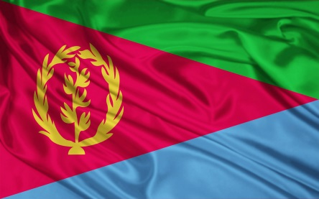
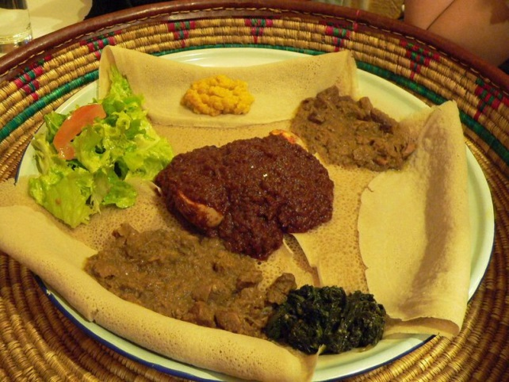
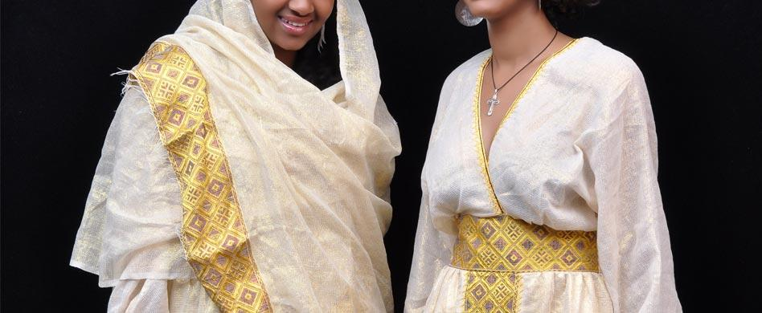
Eritrean Culture
Eritrea gained independence on May 24,1991. They fought for a long time to separate themselves from Ethiopia. Most people speak the language of tygrinya in Eritrea. Most of the traditional music includes drums an chants. The dances include simple movements of the shoulders and movements as a group. The traditional food is injera. Which is bread like and has tiny holes in it; it is usually served with some ort of spicy sauce. The clothing is mostly white(sometimes another color), with colorful designs on the lining. Nigdet is among the most celebrated religious festivities in Eritrea. It is when a certain neighborhood/area holds a celebration for a saint, because they always go to saints for help, and so the celebration is a way of them showing that the saints helped them.

Slide 4
Nepali Culture
Diwali is celebrated to honor the goddess of wealth and god. The festival lasts for five days. The first day is dedicated to cows and we cook rice and feed the cows. The second days is for Vihana of Bhairvana.We light up lamps and we prepare special items for the third day. The fourth day is dedicated to the Hindu god of death. The last day, which is the fifth day, is dedicated to brothers who are wished for a long life by their sisters…

Slide 5
