Slide 1
I am from
Myron Kellogg
Per. 6

Slide 2
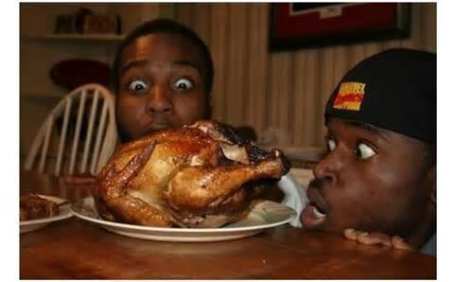
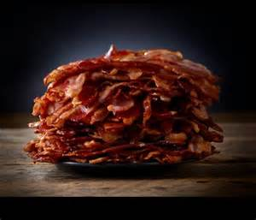
Food food
I AM FROM THE KITCHEN
FROM COOKING BACON AND EATING
CHICKEN

Slide 3
oooh
I am from the couch that feels like butter

Slide 4
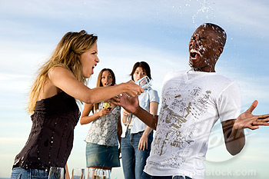
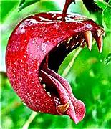
super wet
I from the sky the fruit fly off of and the sweet juicy water fights…whose long gone limbs I remember as if they were my own

Slide 5
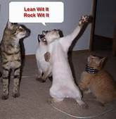
crack up
I from laughter and smiles from walking and getting down

Slide 6
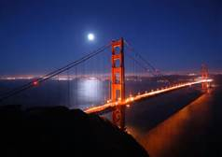
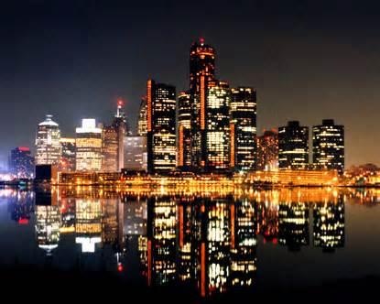
were I'm from
I'm from the city in both state and from Cali and Detroit

Slide 7
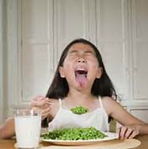
act right
I’m from the eat your vegetables and be nice to other and going boom boom

Slide 8
listen
I'm from the music

Slide 9
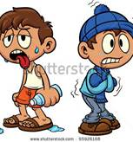
what I'm about
I'm from Michigan and California, the snow and sunlight to hot and cold, pretty eyes and funny smiles

Slide 10
no worry's
I'm from blue sky's to soft clouds to fall asleep with no doubts

Slide 11
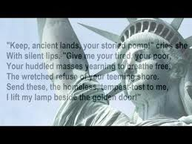
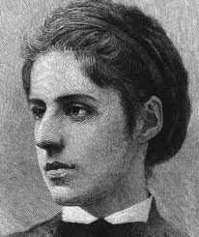
a little of me
I’m from keep ancient land and the iron heel and Mary had an little lame

Slide 12
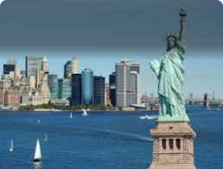
I'm from york city and Portugal ,fried Jewish artichoke and butter,ham,cheese. From Moses and Esther czars to Benjamin n. Cardozo

