Slide 1
My culture
Maria Oliveira Period 7

Slide 2
I’m from brazil

Slide 3
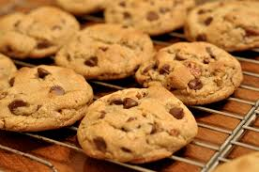
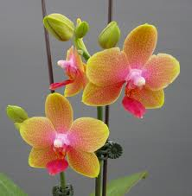
I’m from fresh baked cookies and family portraits. I’m from orchids and catuses.

Slide 4
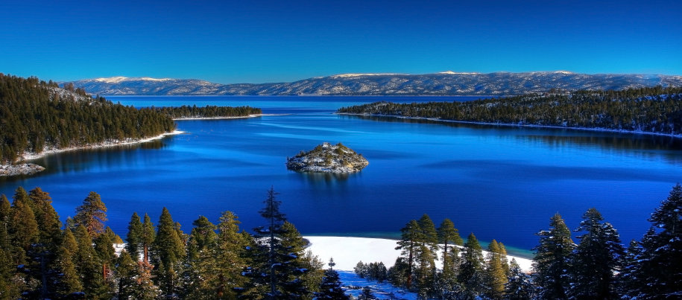
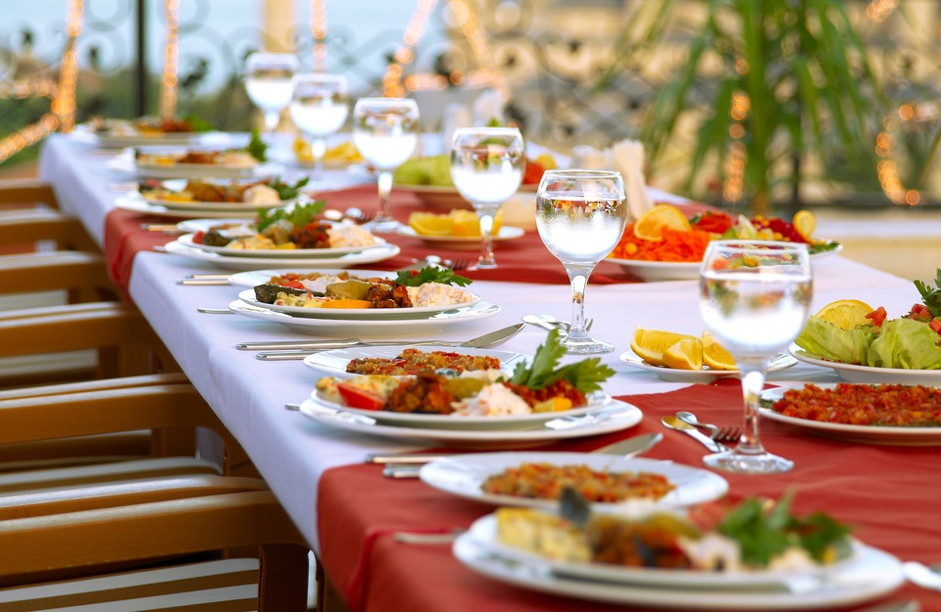
I’m from lake tahoe and Sunday dinners and movie nights.

Slide 5
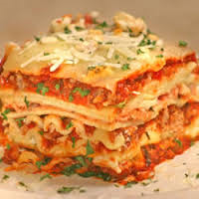
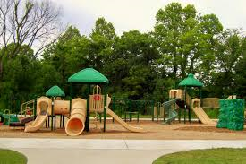
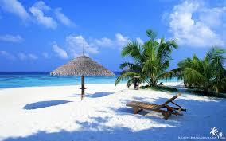
I’m from lasagna and galinhada. I'm from the beaches and parks.

Slide 6
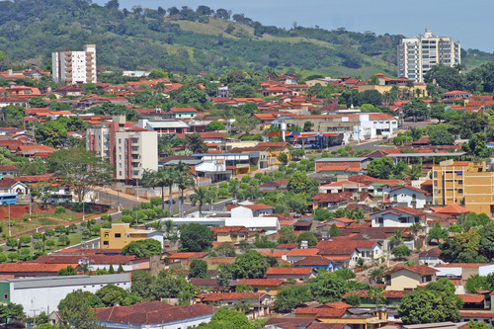
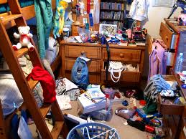
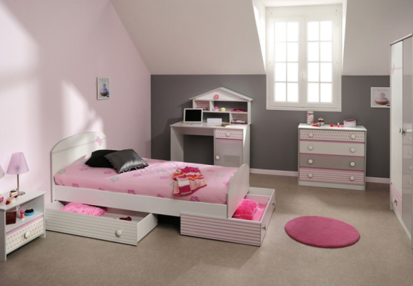
I’m from brazil and ceres. I’m from “don’t touch the electric socket” and “go clean your room!”

Slide 7
The new colossus
Emma Lazarus

Slide 8
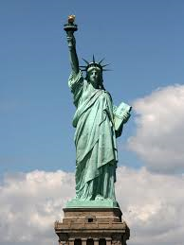
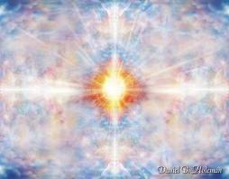
I’m from a mighty woman with a torch and whose flame is imprisoned by lighting and cinderella and the godfather.

Slide 9
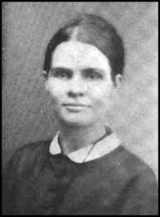
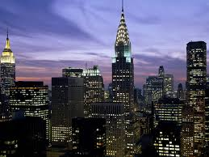
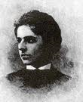
I’m from moses Lazarus and Esther nathan a wealthy family of seven . I’m from new york city and Portugal.

Slide 10
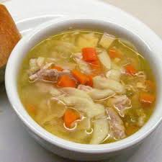
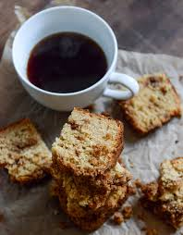
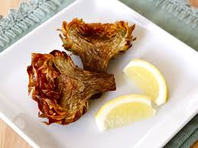
I’m from bread and coffee. I’m from chicken soup and Jewish artichoke.

Slide 11
The end

