Slide 1
Where I’m From
Muhammad Khalid
Period 7
3/17/14

Slide 2
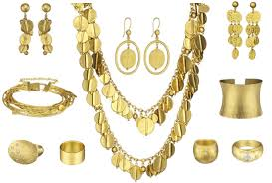
I am from jewelry from clothing and plates. I am from the open roof jasmine. I am from the roses. The grass whose long gone limbs I remember as my own.

Slide 3
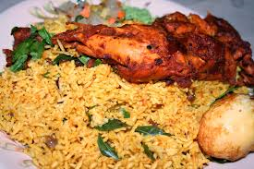
I’m from eid and Friday lunches from mom and dad. I’m from loud talking and helping out and from rushing.

Slide 4
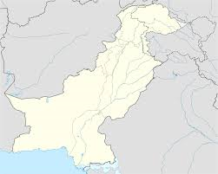
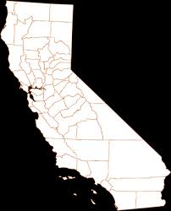
I’m from don’t be afraid and be successful and try hard. I’m from meeting family. I’m California and Pakistan. Tortillas and rice. From my cousin’s stolen bike taken by my nonsense with a funny story.

Slide 5
In my heart remembering.

Slide 6
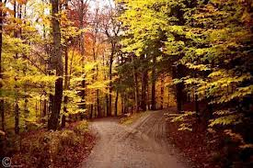
The road not taken
By: Robert Frost
I’m from “a road diverged” and “the road not taken” and who can suffer when roses bloom. I’m from San Francisco. Kippers and Scotch pies. From his father that died when he was 11 years old.

