Slide 1
Monels life where im from
By; montel kellogg period 7

Slide 2
I am from….

Slide 3
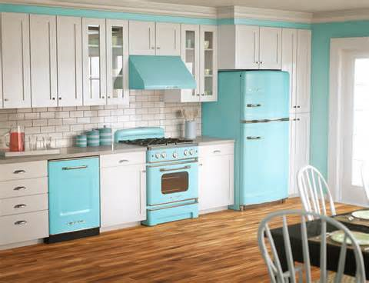
I AM FROM THE OVEN THE KITCHEN AND YOU KNOW WHAT

Slide 4
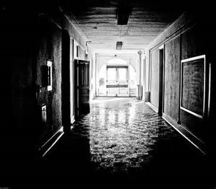
I am from the paint off the walls. A dark feel from the halls

Slide 5
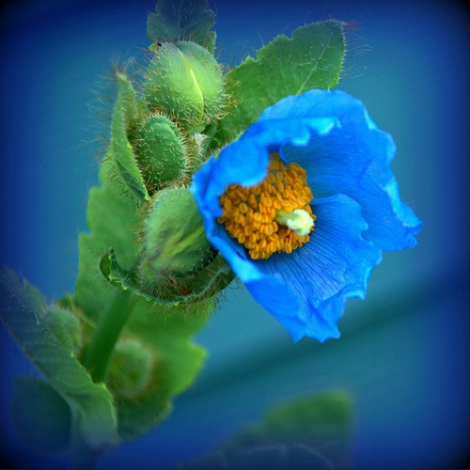
I am the poppy flower , the shortest flower that has all the power

Slide 6
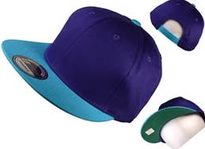
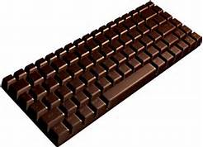
I am from chocolate and hats

Slide 7
and also family

Slide 8
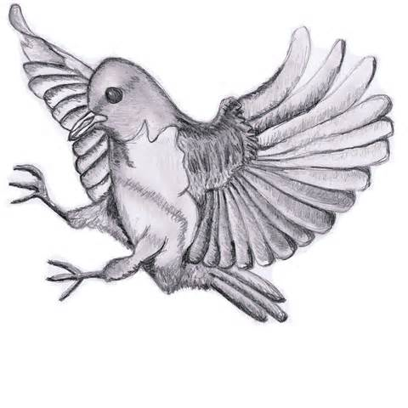
I’m from creativity and drawing

Slide 9
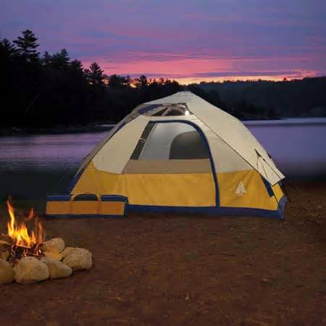
I’m from joking, camping and ‘look what somebody did’

Slide 10
I am from hard work and focus

Slide 11
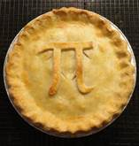
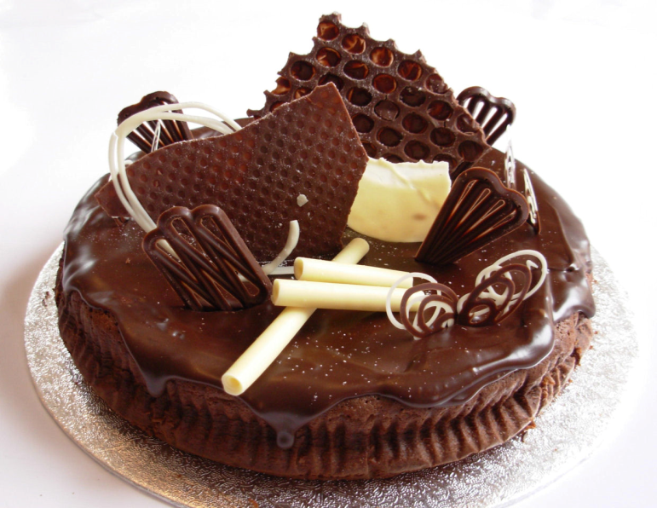
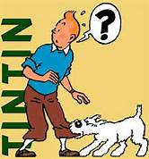
Cake and pie from tin tin and why

Slide 12
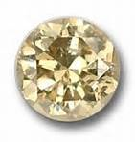
birth stone to my home

Slide 13
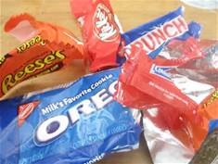
Under my bed there was a box with photos of me and my family, but some of them are gone, like an old rapper with out candy

Slide 14
Emma lazarus
I am from the Statue of Liberty and the fire from the torch , Friday and the city. I’m from drawing and creativity. I’m from Michigan state and California , coffee and soda

