Slide 1
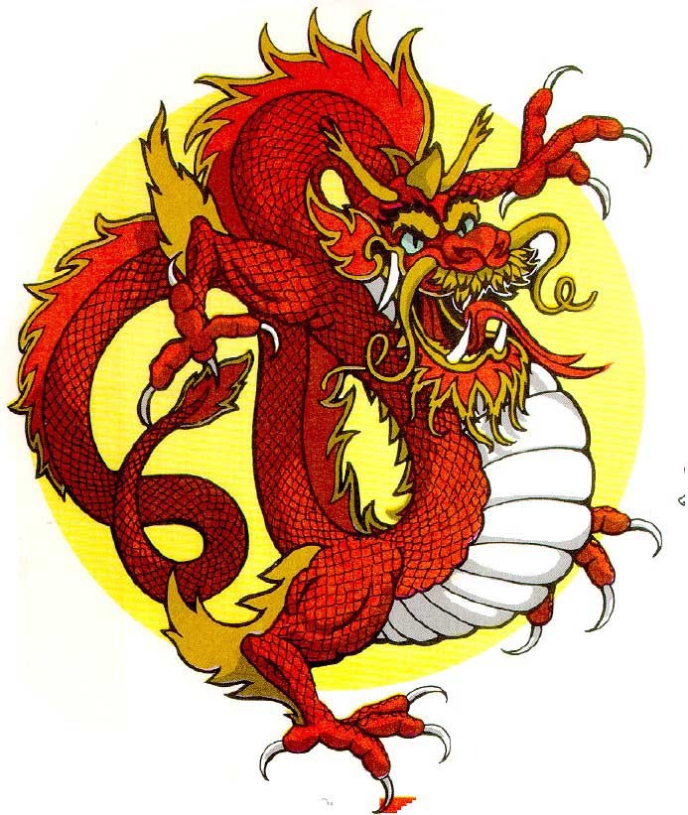
My Culture
By Megan Chen
Period 2

Slide 2
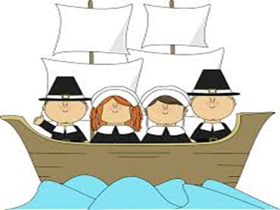
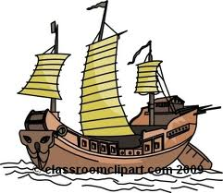
My Background
My mom’s ancestors came from England to America on the Mayflower.
My dad and his family immigrated from Hong Kong to the United States.

Slide 3
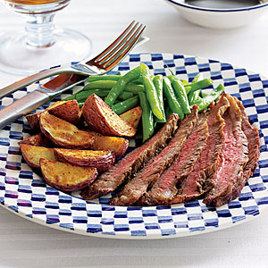
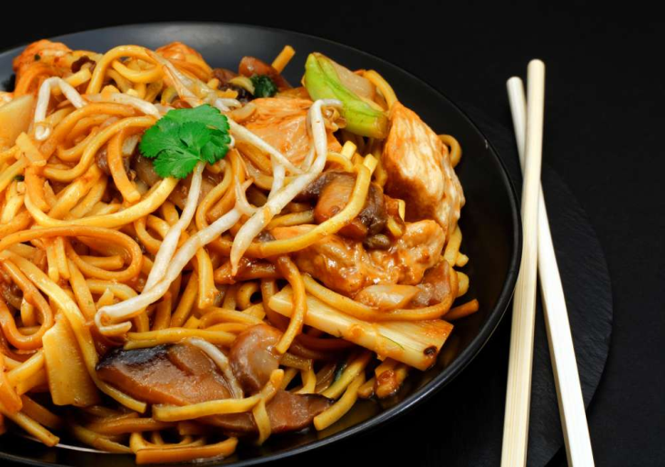
FOOD!
Both sides of my family have one thing in common, FOOD! Whether its noodles to fries to burgers or steak, we eat it all.

Slide 4
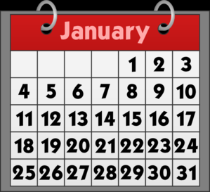
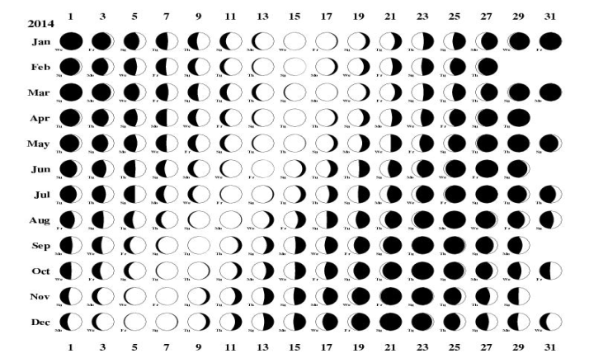
New Year!
For both sides of my family, new years is a very important holiday it happens on different days.
In the United States, new years is always on January 1st because here we use the Gregorian reform while the Chinese uses the lunar calendar so Chinese new year can happen anywhere between January to February.

Slide 5
Conclusion
In conclusion, I love being a mix because I learn different things from both sides. I have learned about Chinese medicine and cooking from my Chinese grandma and my mom has taught me how to make desserts that her grandma taught her.

