Slide 1
Our Culture Our Life
By Massilya Amezdat

Slide 2
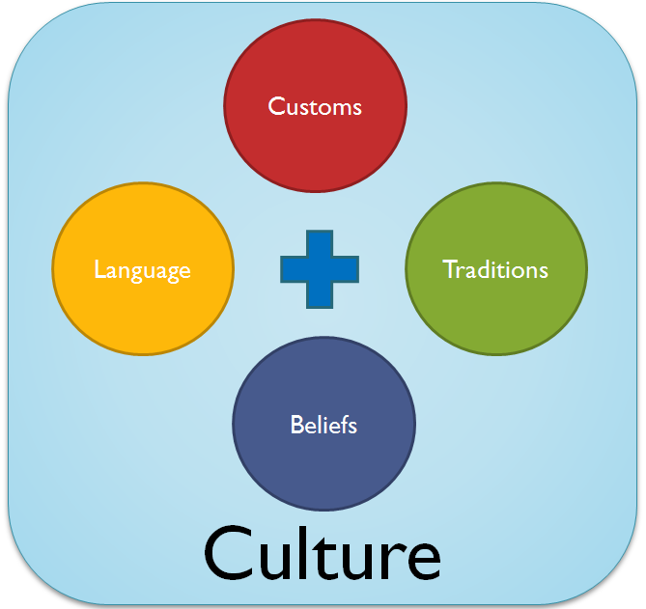
So how do our experiences and/or culture determine what we interpret?
It does, in many different ways. Our culture is what we are basically made of, our essential piece, without it who would we be? Culture is our language, our traditions, our music, and basically all we have inside of us. That’s what determines what we all are, because in the end that is what you will be most proud of ; where you came from.

Slide 3



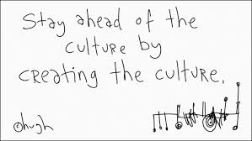

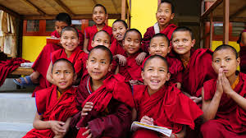


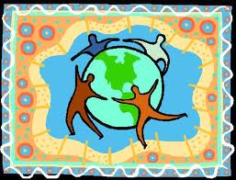
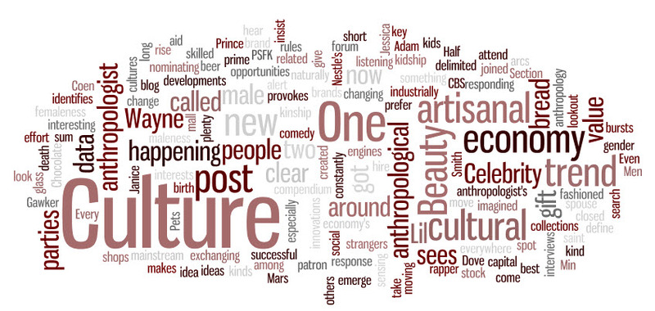


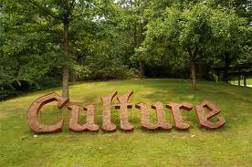
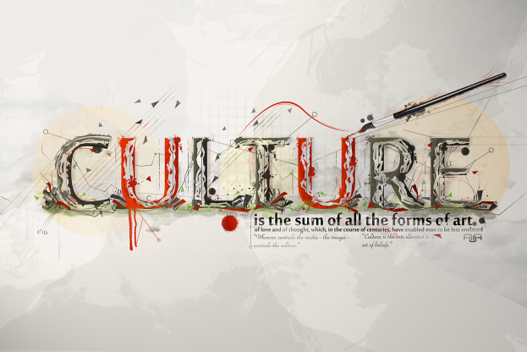


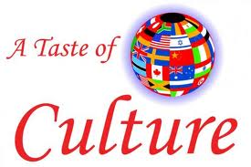


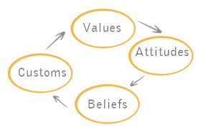

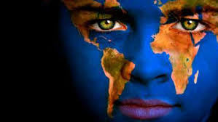

Pictures

Slide 4

My Culture
I am from Algeria, the soccer country My culture is Berber, and my religion is Islam. My ancestors are the Berbers. Both of my parents were born in Algeria as well. My culture has beautiful brightly colored dresses, and headscarf's, eccentric music, henna, dark hair, and more, which I will be showing examples in the next slide. Now a bit about my religion. In Islam, we believe in Allah, the almighty, only, God. In Islam as well they have many rules, like no drinking, no bad manners, very tight gripped things like that. They also say, that if you like, you can pledge yourself to Allah and wear the scarf. We also believe in Hell and Heaven, and as long as you do good deeds on earth you’ll go to Heaven.

Slide 5
Islam
Islam is the religion of the Muslims, a monotheistic faith regarded as revealed through Muhammad as the Prophet of Allah. It is also a strict religion, and you have to work very hard for it. I don’t recommend this religion for lazies.

Slide 6
The BERbers
The Berbers (Berber: ⵉⵎⴰⵣ( the sign on my left is on the Berber flag) ⵉⵖⴻⵏ, Imazighen / Imaziɣen in plural, and Amazigh in singular) are the ethnicity indigenous to North Africa west of the Nile Valley. They are distributed from the Atlantic Ocean to the Siwa Oasis in Egypt, and from the Mediterranean Sea to the Niger River. They were caravans that traveled the desert with camels, and traded items with neighboring towns.

Slide 7
Algeria
This is were my parents were born from. Algeria, officially The People's Democratic Republic of Algeria, is a country in the Maghreb region of North Africa on the Mediterranean coast. Its capital and most populous city is Algiers, and Algerie’s was were one of my parents where born in.

Slide 8
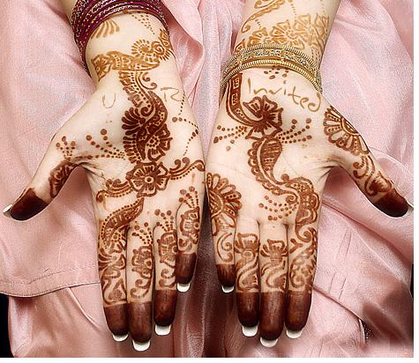
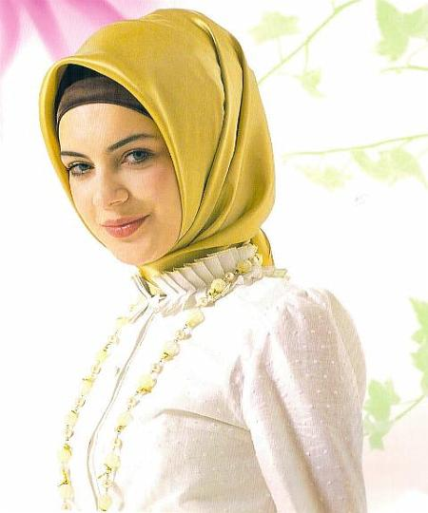
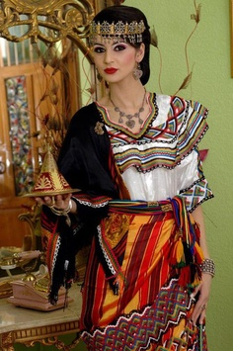
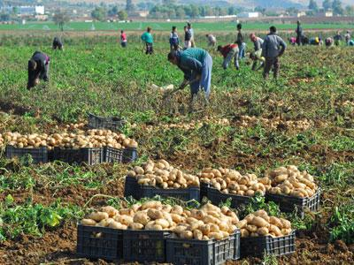
Examples:
In our culture we also do Henna, as shown:
Also we have the choice to wear headscarf’s
Such as this one:
And colorful dresses like this:
Another thing I forgot to add
Is farming...Algerians love to
Farm:

Slide 9
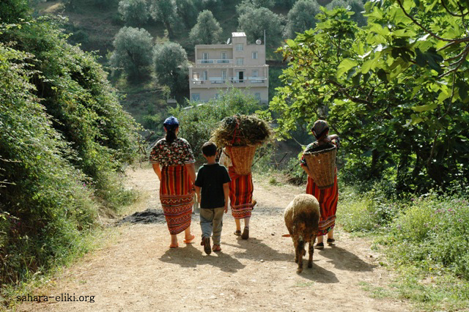
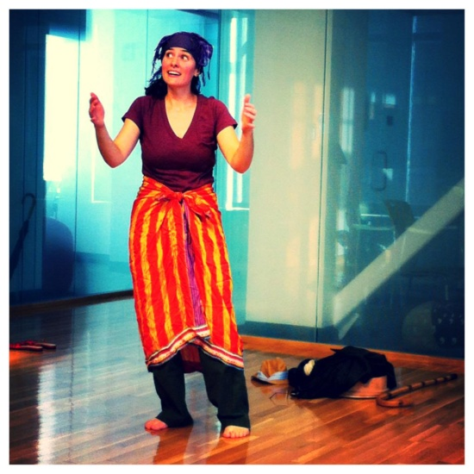
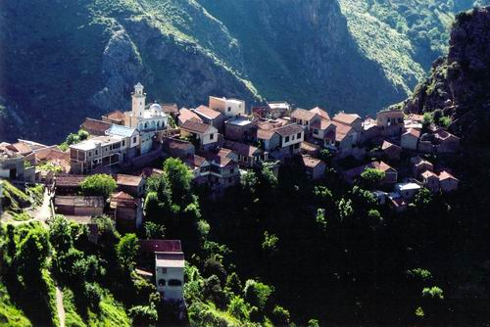

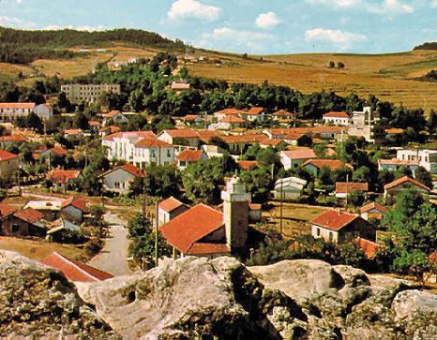
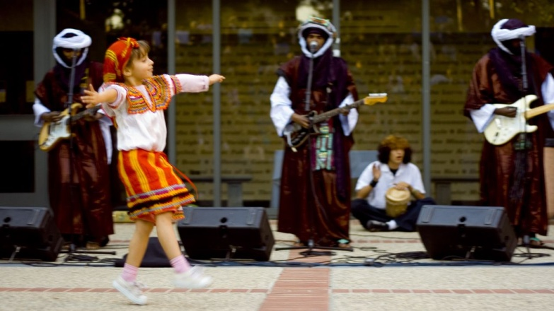
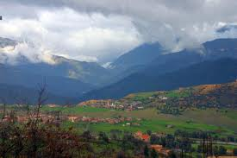
Let’s Now Have a Momentum.

Slide 10
Evidence From the Stories
Baseball, for me is literally 4 days in Hell, but I have a cousin who loves baseball and carries a glove wherever he goes.
“…Andersen’s fantasies.. But his main contribution was to make us look for sharply at daily life through the window of his imagination
For example I love drawing anime, and I am doing the thing I love almost everyday, and it feels like a part of me.
This shows that music , especially the blues etc.. Were part of the American History, which was part of the American Culture.
Yes Our Culture Does Affect us in many different way because your culture is a part of who you are.
“..The roots of rhythm and blues are deeply woven into the American history..”
Page 489
I play three different instruments, and different types of music. I enjoy the sound that comes out of them and it soothes me
“..In a country full of sport stars, he somehow stands out..”
This shows that he, loved baseball and was very good at it, and always tried his hardest. But at the same time he enjoyed it because it was part of who he was.
My reaction was that Anderson’s culture was his stories, and art and how he enjoyed putting smiles on children’s face

Slide 11
Conclusion/Summary
In conclusion, there will be different people from all over the world in America, there will be all different types of religions, races, and more. All we can do is learn to accept their ways, and learn new things. We will learn how to become friends, and perhaps allies, other than enemies and start wars. Because this month was presented to show all of the cultures, and all of their customs, and how we should all be friends, which will take a few steps to get moving.
                Thank you

