Slide 1
“I am” poem
BY: Mariela isabel lopez

Slide 2
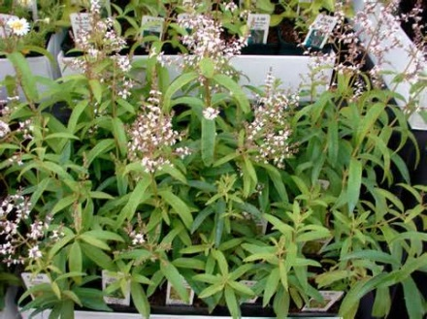
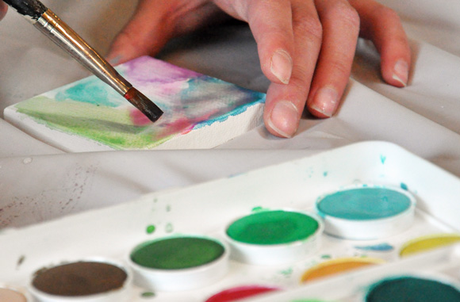
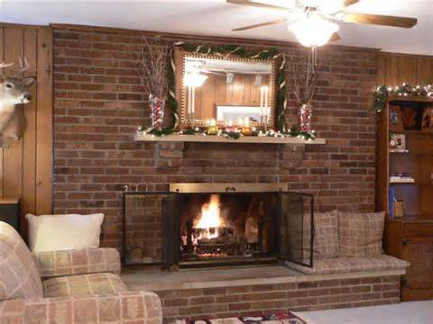
I am from guitars, food, paintings…
From watercolors and canvases
I am from the bricks on my fireplace
And the scent of warm food on the table
I am from the rose garden at my grandma’s house
I am from the lemon verbena whose long gone limbs I remember as if they were my own

Slide 3
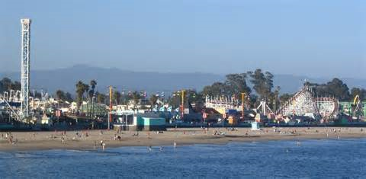
I’m from gatherings and long trips to Santa Cruz
From Hector and Carolyn
I’m from laughing and joking and from having family parties

Slide 4
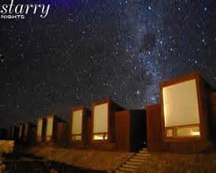
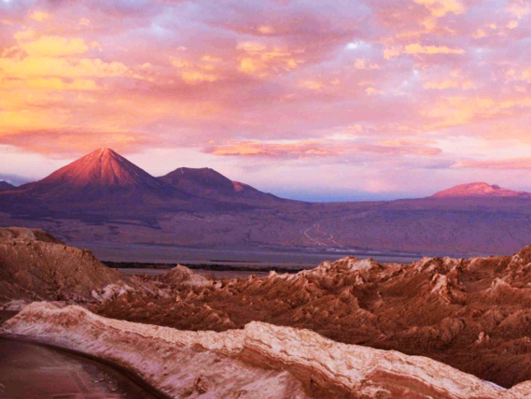
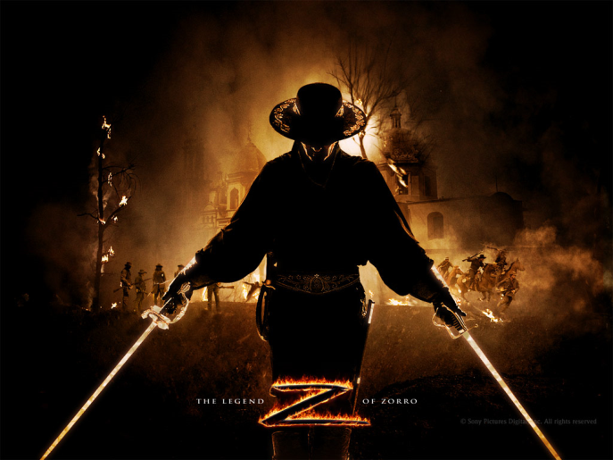
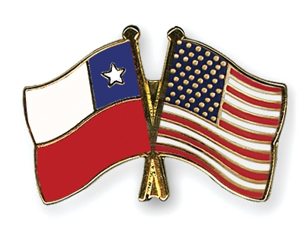
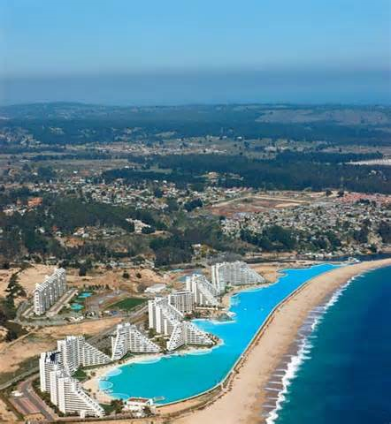
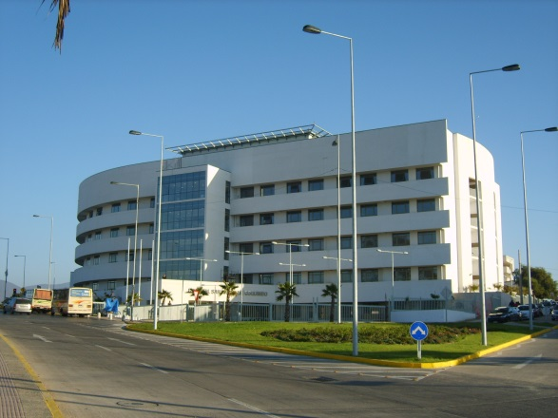
I’m from Zorro and pirates
And “momentos”
I’m from traveling to Chile
I’m from San Pablo Hospital and White and Chilean
San Pablo Hospital
Biggest swimming pool in Algarrobo, Chile

Slide 5
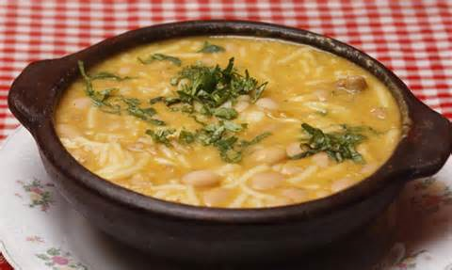
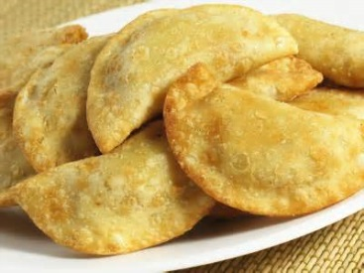
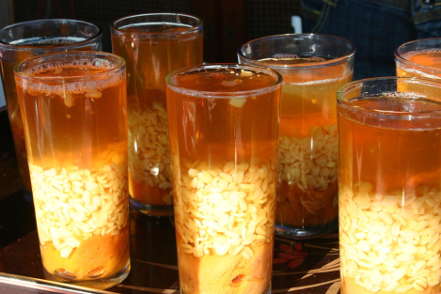
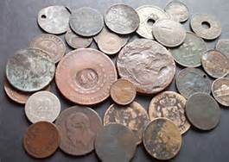
Cazuela and empanadas de queso
From “que linda familia” which is something my grandpa says ironically
From Big noses and foreign coins
In my cabinet, scattered memories and pictures of people I have never met

Slide 6
Emma Lazarus
Author of Colossus

Slide 7
I’m from Jack London’s “The White Silence” and “The Call of the Wild”
And Stephan Foster’s song “Camp Town Race”
I’m from writing and learning languages
I’m from New York City, New York and I’m Portugese, German, French, and Italian
Matzah and Challah
From Moses Lazarus and Esther Nathan

