Slide 1
IM FROM>t
KEITH SAMSON>>PERIOD7>>MARCH 19,2014

Slide 2
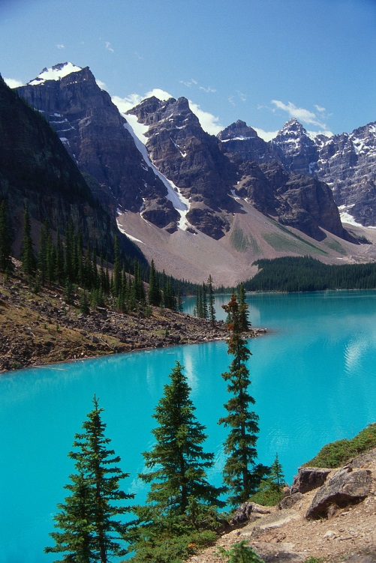
I’m from god’s place, from mountains and rivers.

Slide 3
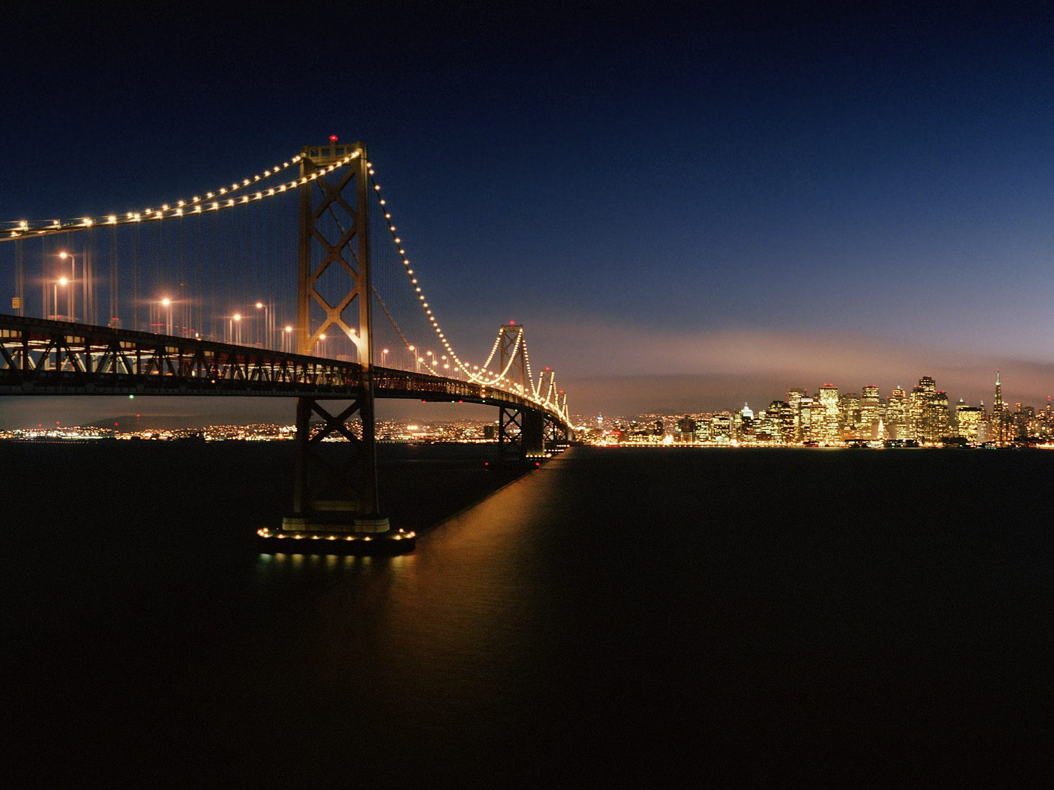
I’m from the rich city, comfy and warm

Slide 4
I am from the sunflower, the roses by the porch whose long gone limbs I remember as if they were my own.

Slide 5
I’m from supreme clothing and propaganda

Slide 6
I’m from oliver and p-lo, I’m from movies, music and parties

Slide 7
I’m from being smart and responsible, and going to work.

Slide 8
I’m from Philippines and Filipino, soup and chicken.

Slide 9
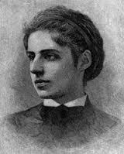
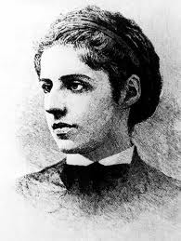
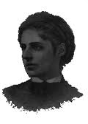
Emma Lazarus “The New Colossus”
I’m from New York and Portugal and snow white and rose reds, I’m from Brazil I’m from New York city and Portugal, Chicken soup and caramel custard, Benjamin N. Cardozo

