Slide 1
MY CULTURE
By Kaylee Wong

Slide 2
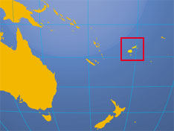
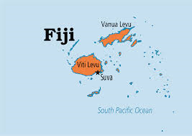
My parents are from the Fiji Islands.
Fiji is located in the South Pacific, near New Zealand and Australia. My parents were both born in Suva.

Slide 3
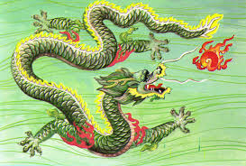
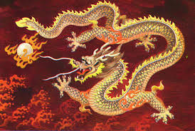
But, your last name is “Wong”?
My great-grandfather was Chinese and married my great-grandmother, who was from Fiji.
My grandfather is half-Chinese.
My Dad, a quarter Chinese.
Thus, my last name, “Wong”, and making me an eighth Chinese.

Slide 4
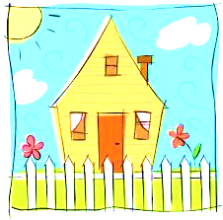
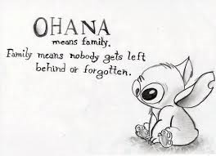
I have a few siblings.
I have three older half siblings, two brothers and one sister, who are all in their late twenties and early thirties.
I have one older sister, one younger sister, and two younger brothers.

Slide 5
School Culture
I went to Kensington elementary school.
Apparently, in kindergarten I had a
New Zealand accent. ( from listening to my
Mom so much)
I then came here to Portola Middle school.

Slide 6
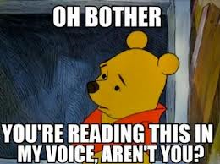
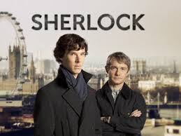
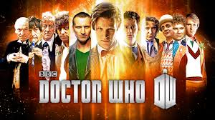
Youth Culture
As a child, my parents read a lot of books to me, encouraging me to read.
My Mom would watch British mystery
TV shows like “Miss Marple” and “Poirot”.
This affected the my taste in books and TV.

Slide 7
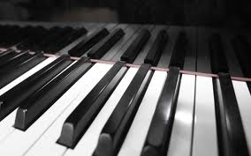
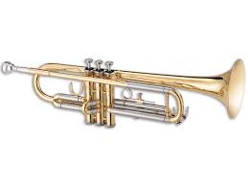
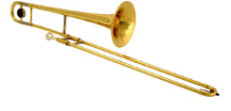
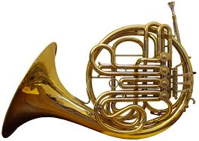
Youth Culture continued…
I’ve always been immersed in music.
When I was six years old I started taking piano lessons.
In fourth grade, I started playing the
trumpet.
Over the summer, I learned how to
play the trombone.
I recently began learning how to play the french horn.

Slide 8
My Culture
By Kaylee Wong
THE END!!!

