Slide 1
I am from…MB
Jesse Perkins//March 21//Period 7

Slide 2

I am from a heavenly lighted home smudged with a cedar tree smell.

Slide 3

I am from traditional pottery and the Rose whose long gone limbs I remember as if they were my own.

Slide 4
I am from ceremonies and sweat lodges. From native leaders Sosakete and Tahawisoren.

Slide 5
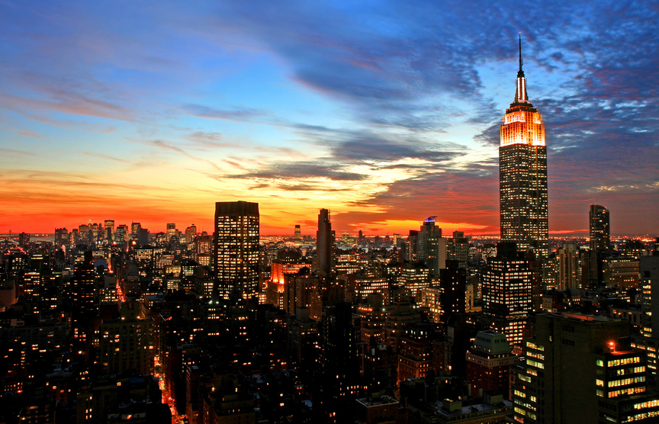
I am from adventure stories and cultural tales. I am from family dinners. I am from Saranac Lake, New York and Fort Covington, NY.

Slide 6
I am from fry bread and corn soup. I am from hockey and basketball. I am from a fireplace.

Slide 7
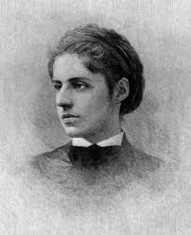
I am from New York City. From Esther and Moses Lazarus. From European languages and from old Jewish tales. I am from the New “Colossus”. I am from West 10th st. Brooklyn.
Emma Lazarus
“New Colossus”

