Slide 1
I am from…
Jennifer Madrid
Period 7

Slide 2
I am from socks from picture frames and mirrors
I am from quiet
I am from daisies
The tree who's long limbs I remember as if they were my own

Slide 3
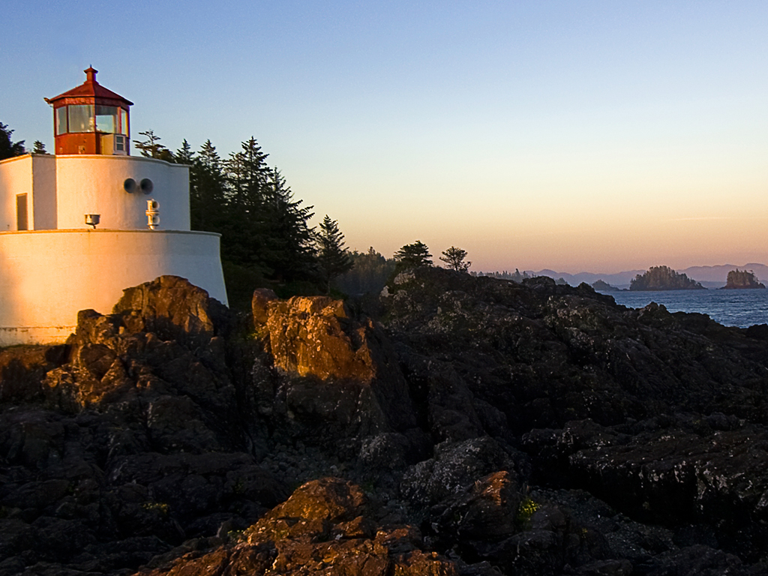

Slide 4
Emma Lazarus
The New Colossus

Slide 5
I’m from A study in Scarlet and Treasure Island

