Slide 1
My life story
BY, Jayla Paysinger

Slide 2
I am from a big loving family that goes shopping, cooks, watches TV, sleeps, and has family reunions. Also that sing’s songs in the shower and taking pictures every holiday season. Lastly I’m from a big warm comfortable bed, A big fichus tree, fried crab ,and singing twinkle little star with my sister.

Slide 3
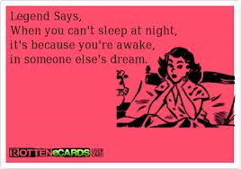
A quote that I always remember is…

Slide 4
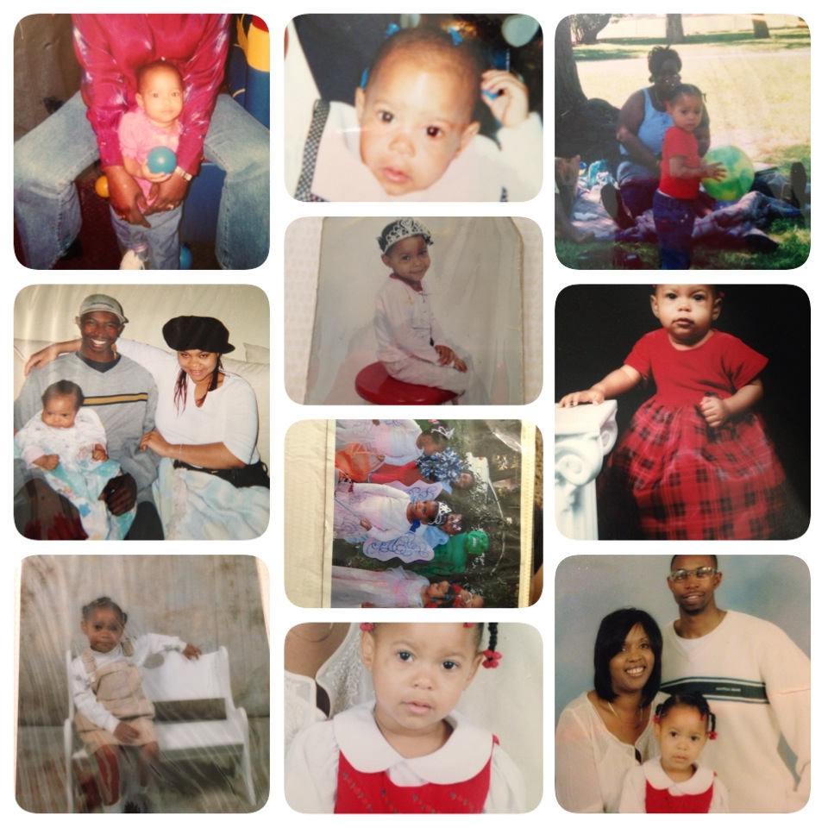
A picture of when I was little…

Slide 5
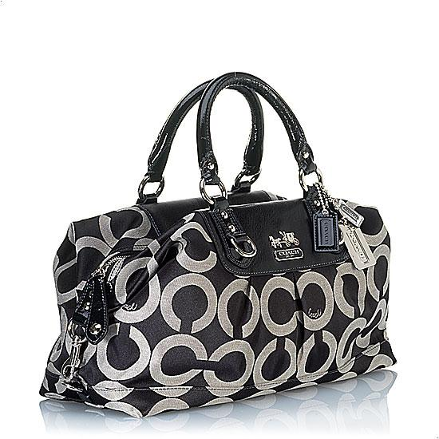
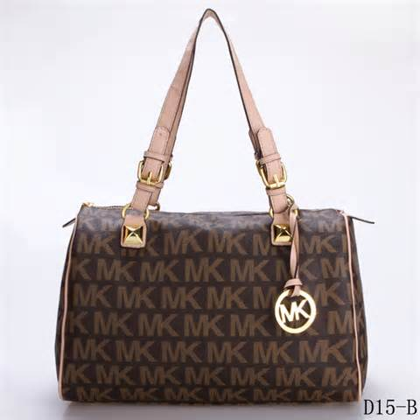
My hobby is shopping

Slide 6
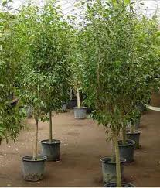
I have a couple of ficus trees in my house

Slide 7
This is where I was born

Slide 8
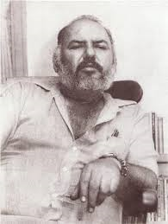
Old Man By Ricardo Sanchez
I’m from “old man, loved and respected, he would speak sometimes of pueblos” and “who felt the heated sweetness of chile verde”
And Los Lobos
I’m from love for community and family.
I’m from El paso,Tx and New Mexico

