Slide 1
I am from
By
Michelle Hernandez
7 period

Slide 2
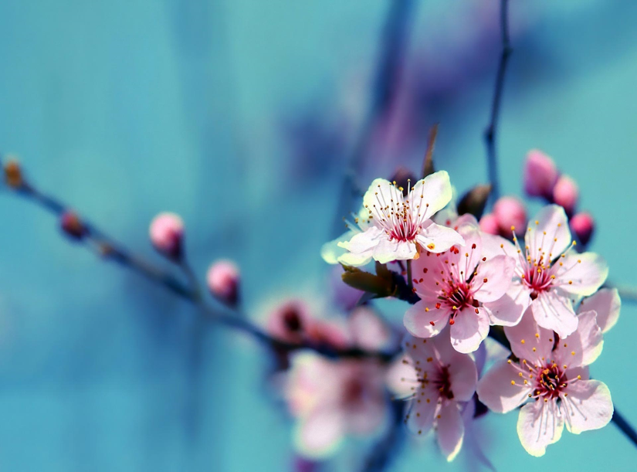
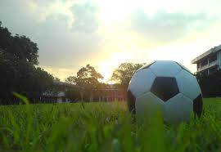
I am from flowers, from piano playing and soccer balls

Slide 3
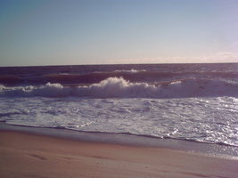
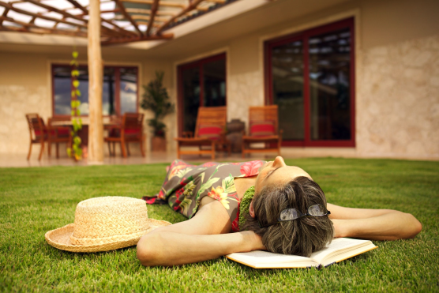
I am from the relaxing home , the sent of ocean breeze

Slide 4
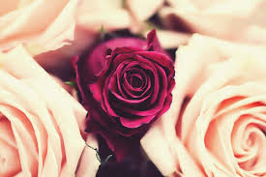
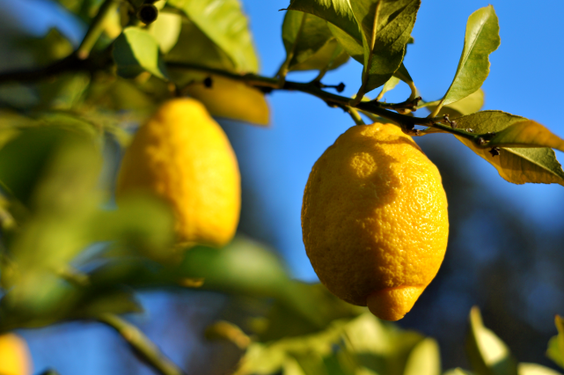
I am from the roses, the lemon tree who long gone limbs I remember as if they were my own

Slide 5
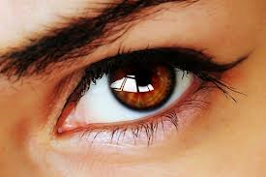
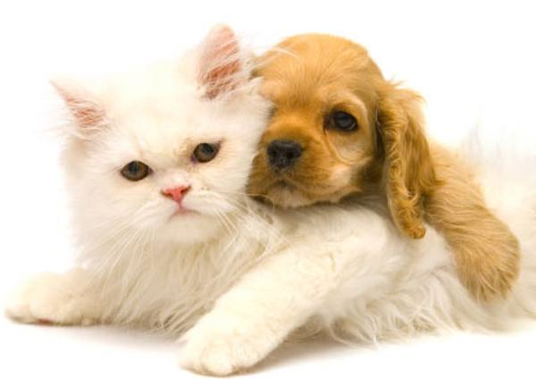
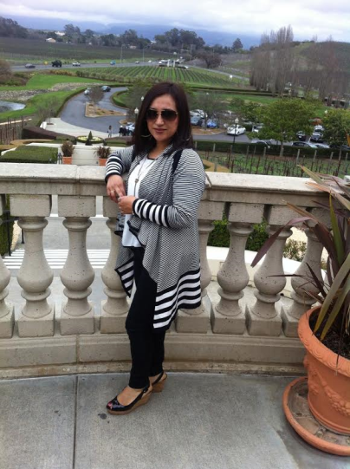
I’m from brown eyes and dogs, cats from Angelica and Ernesto

Slide 6
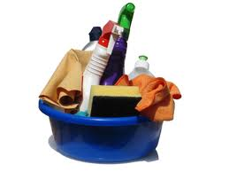
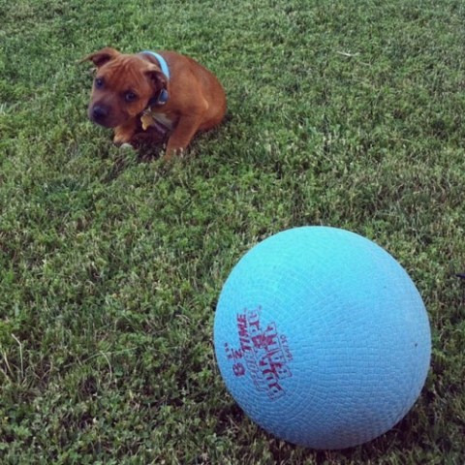
I’m from hard cleaning and taking the dog out and from going shopping

Slide 7
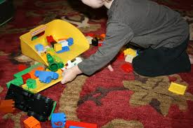
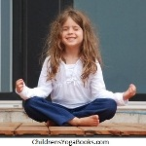
I’m from calm and my brother was wild and clean up times

Slide 8
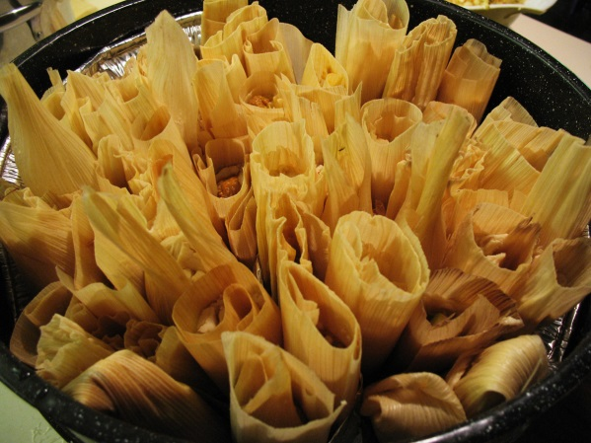
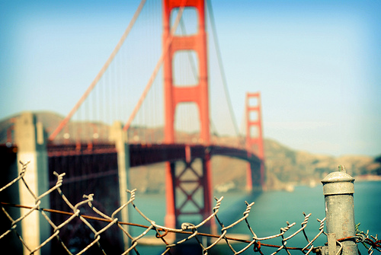
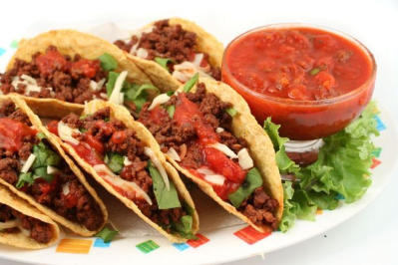
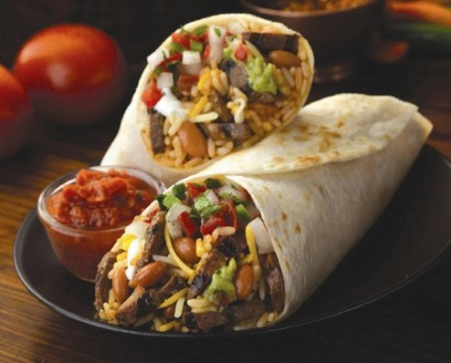
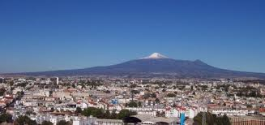
I’m from making tamales, I’m from San Francisco and Mexico, tacos and burritos

Slide 9
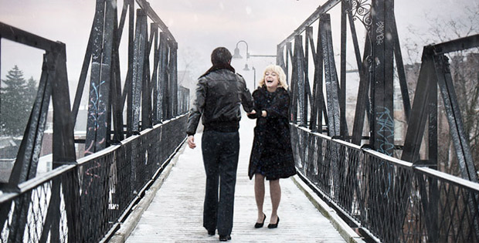
From funny stories , like when I was a little kid I fell on my uncle when he was sleeping and I told him to wake up

