Slide 1
How To Write Really Good Dialogue
From http://ywp.nanowrimo.org/files/ywp/nano_ywp_09_e_good_dialogue.pdf

Slide 2
Dialogue
is what two or more characters say to each other.
The exact words they speak are put between quotation marks.
We experience dialogue all the time in our everyday lives.

Slide 3
Here's some dialogue you might hear on any given day:
"Hey, dude. How are you?" John said.
"I'm really good. Thanks for asking. And you?" Sam said.
"Good, thanks," John said.
Of course, this kind of dialogue is really important to everyday life. If we didn't say hello and ask people how they were doing, we might lose a lot of friends, fast. But in books, this kind of daily dialogue is boring.

Slide 4
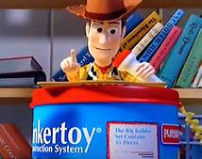
Dialogue should:
1. Move your story forward
2. Help someone who is reading your book get to know your characters better

Slide 5
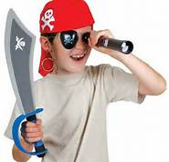
Dialogue that moves your story forward:
"Captain, we've spotted something on the horizon!" Pirate Willy yelled, pressing the binoculars to his eyes.
The Captain ran up to him, snatching the binoculars out of Willy's hands.
"That's impossible!“
The Captain immediately saw that Pirate Willy was right. There was something on the horizon. And it was gaining on them.
The Captain cursed and shouted to his crew, "Full sail! We have to outrun them!"

Slide 6
This dialogue has our attention right from the start! As readers, we're already asking the questions: What did the pirate spot on the horizon? Are the pirates going to get out alive? We want to know what happens next. If the writer had spent three pages going back and forth between Willy and the Captain about how delicious breakfast was, by the time we got to the mysterious thing on the horizon, we'd already be asleep.
"Captain, we've spotted something on the horizon!" Pirate Willy yelled, pressing the binoculars to his eyes.
The Captain ran up to him, snatching the binoculars out of Willy's hands.
"That's impossible!“
The Captain immediately saw that Pirate Willy was right. There was something on the horizon. And it was gaining on them.
The Captain cursed and shouted to his crew, "Full sail! We have to outrun them!"

Slide 7
Dialogue that helps readers get to know your characters:
"Excuse me young man," Mark said, awkwardly. "But what is that thing you're pressing into your ear? Is it some kind of futuristic robot?"
Greg, who was talking on his cell phone, looked up at Mark, annoyed.
"It’s my phone, dude! What planet are you from?"
"I am from planet Earth," Mark said. "I never saw anything like it. I am from the year 1401.“
"Whatever. Could you leave me alone? I’m in the middle of an important conversation here." Greg walked quickly away from Mark.

Slide 8
It's clear from reading these few lines that Mark and Greg are very different people. Mark has time traveled from the year 1401 and Greg lives in the present. Greg loves talking on the phone so much that he could care less about meeting a time traveler!
"Excuse me young man," Mark said, awkwardly. "But what is that thing you're pressing into your ear? Is it some kind of futuristic robot?"
Greg, who was talking on his cell phone, looked up at Mark, annoyed.
"It’s my phone, dude! What planet are you from?"
"I am from planet Earth," Mark said. "I never saw anything like it. I am from the year 1401.“
"Whatever. Could you leave me alone? I’m in the middle of an important conversation here." Greg walked quickly away from Mark.

Slide 9
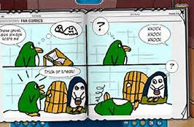
Comic Strip Exercise
Writing really good dialogue is like writing a comic strip. Comic artists only have so many boxes to fill before they run out of room. If they spend too much time on dialogue like "Hey, dude, how are you?" pretty soon, they've run out of boxes! To help you understand how boring this kind of dialogue can be, we've put together a nifty example of a boring comic strip. Check it out!

Slide 10
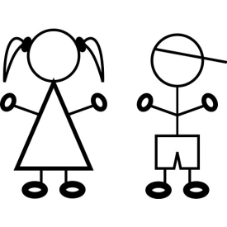
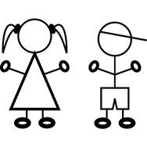
Boring Dialogue
“Hey there.”
“Hi. How are you?”
“I’m good.”
“That’s good.”
“(…)”
“I talked to Donnie yesterday.”
“Oh, that’s cool.”
“(…)”

Slide 11
Pretty lame comic, huh? Now it's your turn to write some dialogue that's actually good! Fill in the following three blank "Comic Strip Worksheets"
1. On the first one, write a conversation between your main character and your villain—they probably have a lot of things to say to each other that will keep a reader's attention! Remember that your dialogue should either
move your story forward or help your reader get to know your characters.
2. On the other two, you can either write more conversations between your main character and villain, or you can bring in your supporting characters.

Slide 12
Dialogue Tags Other Than “Said”
agreed
answered
argued
asked
begged
complained
cried
giggled
hinted
hissed
howled
interrupted
laughed
lied
mumbled
nagged
promised
questioned
remembered
replied
roared
sang
screamed
screeched
shouted
sighed
snarled
sobbed
warned
whispered
yelled

