Slide 1
I am from
Fatima Camacho
7th period

Slide 2
I am from family pictures from paintings and glass table.
I am from the worm and safe smell of flowers.
I am from the roses the peach tree whose long gone limbs I remember as if they were my own.

Slide 3
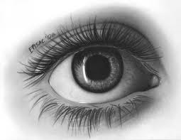
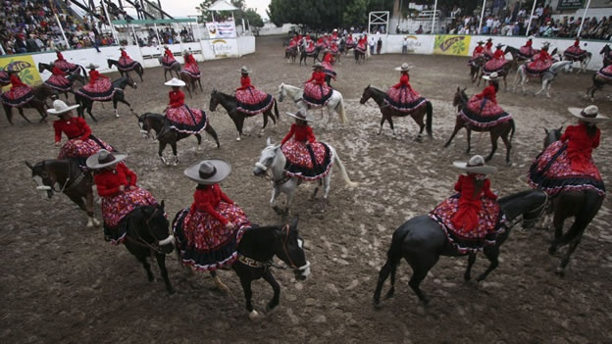
I’m from 5 de Mayo and Mother’s Day from Javier and Teresa.
I’m from lunares and eyes and from ya bamonos.

Slide 4
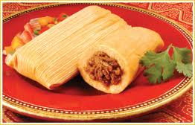
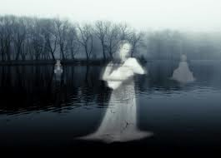
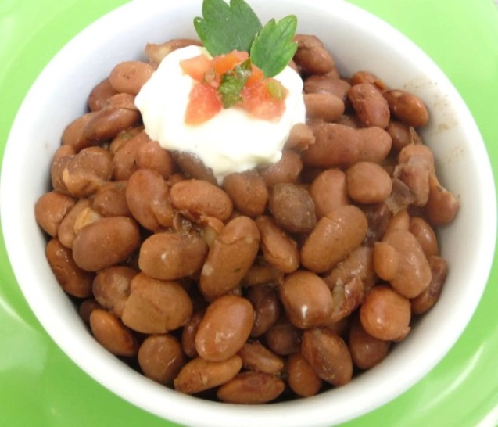
I’m from “hay Fatima que isiste” and “portate bien” and “Afuera de Mi Patio”.
I’m from walks in the park.
I’m from Zacatecas and Guadalajara beans and tamales.
From la llorona always crying for her kids lakes, rivers, and rocks.

Slide 5
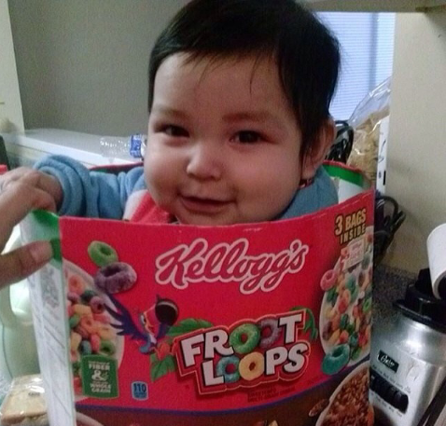
Pictures of my baby nephew.

Slide 6
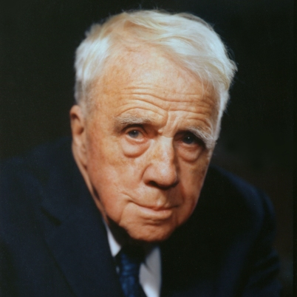
ROBERT FROST
I’m from “two roads” and “witch one should I take” and “miles to go before I sleep”.
I’m from my dad’s death.
I’m from San Francisco and New England From fried fish sandwiches to lobster rolls, from blueberry pie to ice cream.

