Slide 1
I AM FROM
EZRA GUERRERO
Period 7

Slide 2
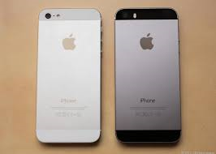
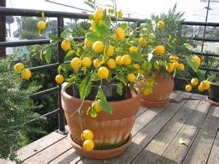
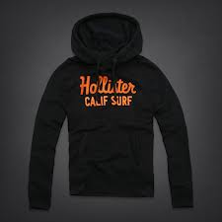
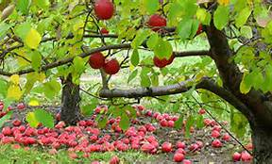
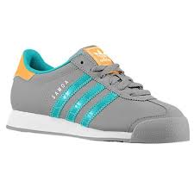
I am from PLAYING ON my PHONES I am from shoes And clothes I am from lemon tree the apple tree

Slide 3
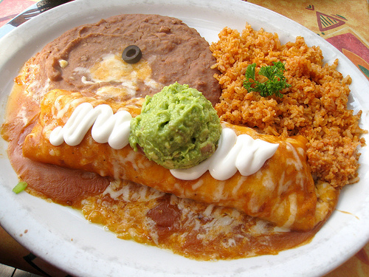
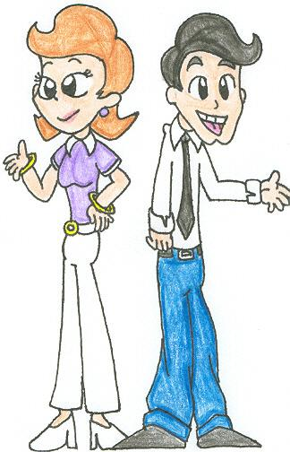
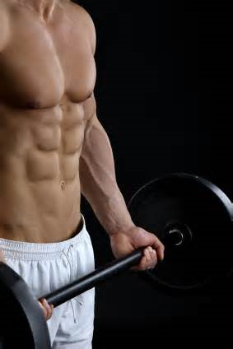
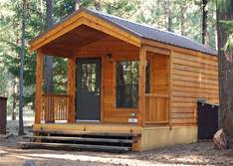
I'm from Mexican food from scott and hazel and junk food and exercise and going to a cabin

Slide 4
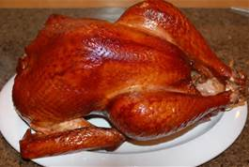
I’m from moving to el Cerrito from Merced and having a special painting I'm from being brave and “stop crying” and having a turkey every year I am from “twinkle twinkle little star”

Slide 5
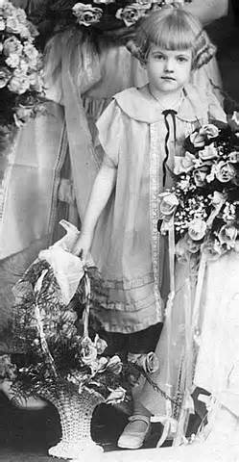
On my sisters wall the painting was a painting of my mom

Slide 6
EMMA LAZURAS NEW COLLOSUS

