Slide 1
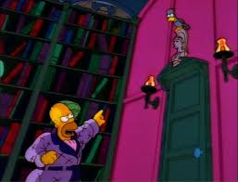
The Raven
By Edgar Allen Poe

Slide 2
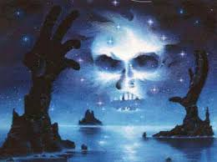
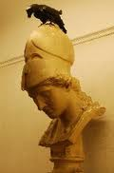
Vocabulary
Plutonian
=relating to the Underworld
Pallas
= Athena, goddess of wisdom

Slide 3
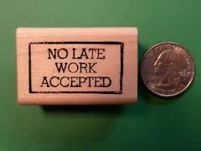
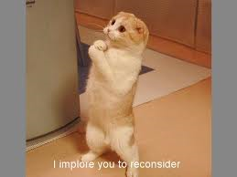
Vocabulary
implore
=ask for
nevermore
= at no time hereafter

Slide 4
Summary
In “The Raven” by Edgar Allen Poe, during a cold December night, the narrator was dozing off thinking about his late wife, but a raven interrupts his peaceful time by answering “nevermore” to the narrator’s questions. Soon the narrator's questions turn serious and he fears the bird is a demonic being that reminds him of his “lost Lenore” and will not leave “the bust above his chamber door”.

Slide 5
Concisely Summarize the Work
Example: In “The Raven” by Edgar Allen Poe, during a cold December night,the narrator was dozing off thinking about his late wife, but a raven interrupts his peaceful time by answering “nevermore” to the narrator’s questions. Soon the narrator's questions turn serious and he fears the bird is a demonic being that reminds him of his “lost Lenore” and will not leave “the bust above his chamber door”.
SOMEBODY = Identify the author and title. Give the main character and setting.
WANTED = Identify what the main character wants/goals.
BUT = Identify conflict that the character faces.
SO = Describe the resolution of the conflict.

Slide 6
Character Sketch
The narrator
depressed
He says, “ eagerly I wish the morrow”= wanting time to pass quickly.
He has “sorrow for the lost Lenore”.= he’s been thinking of his dead wife.
spiritual
Calls the raven a “prophet” which is an individual who has come in contact with a divine or supernatural being.
“Plutonian shore”= refers to the underworld and the raven coming from there.
“thing of evil!”=Believes raven is a bad omen
Reading in chamber, alone at night
Can you add more to this?

Slide 7
Change in Character
At the beginning of the story
In the middle and by the end of the story
1st: ponderous="betook myself to linking Fancy unto fancy, thinking what this ominous bird of yore—...Meant in croaking 'Nevermore.'“—...Meant in croaking 'Nevermore.'"
2nd: anxious and angry that he can't figure out what the bird means. He demands to know, he yells, "implores", "shrieks", to no avail.
What stayed the same
"weak and weary" (line 1)
Alarmed scared= "filled me with fantastic terrors never felt before“ (14)and "wondering, fearing, doubting, dreaming (19-20)."
Sad
Mourning the lost of Lenore
Depressed= he has "sorrow for the lost Lenore“(10).

Slide 8
Discussion Questions
Character
Character changes
Some people claim that the narrator of the poem has gone mentally insane. What evidence can you find of this?
What do you think? Was the narrator dreaming, mentally unstable or just filled with grief?
Why did he first welcome the appearance of the raven?
Why did he change his attitude towards the

