Slide 1
My life
by elias mendoza

Slide 2
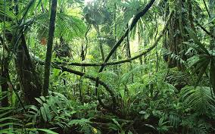
I am from I pod’s and earphones and laptops I’m from the jungle , court

Slide 3
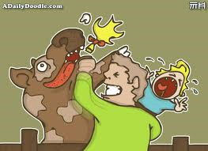
☺
I’m from “don’t hit your sister”to “ go clean your room” from dad to mom I am from “be quiet” and “go do your work!” and from

Slide 4
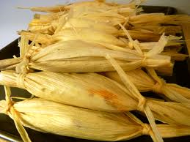
I’m from “don’t lose your phone’’ and “never break a promice ” and “the sky is the limit” I am from eating tamales I am from san Francisco and Guatemala

Slide 5
Akayah burmbra
I’m from the storyteller and in a tone of distance regret and the storyteller , I’m from writing stories I’m from Akyah , Burma and British rice and beverage from Mary Frances Marcer was charged by a cow

Slide 6
☺

