Slide 1
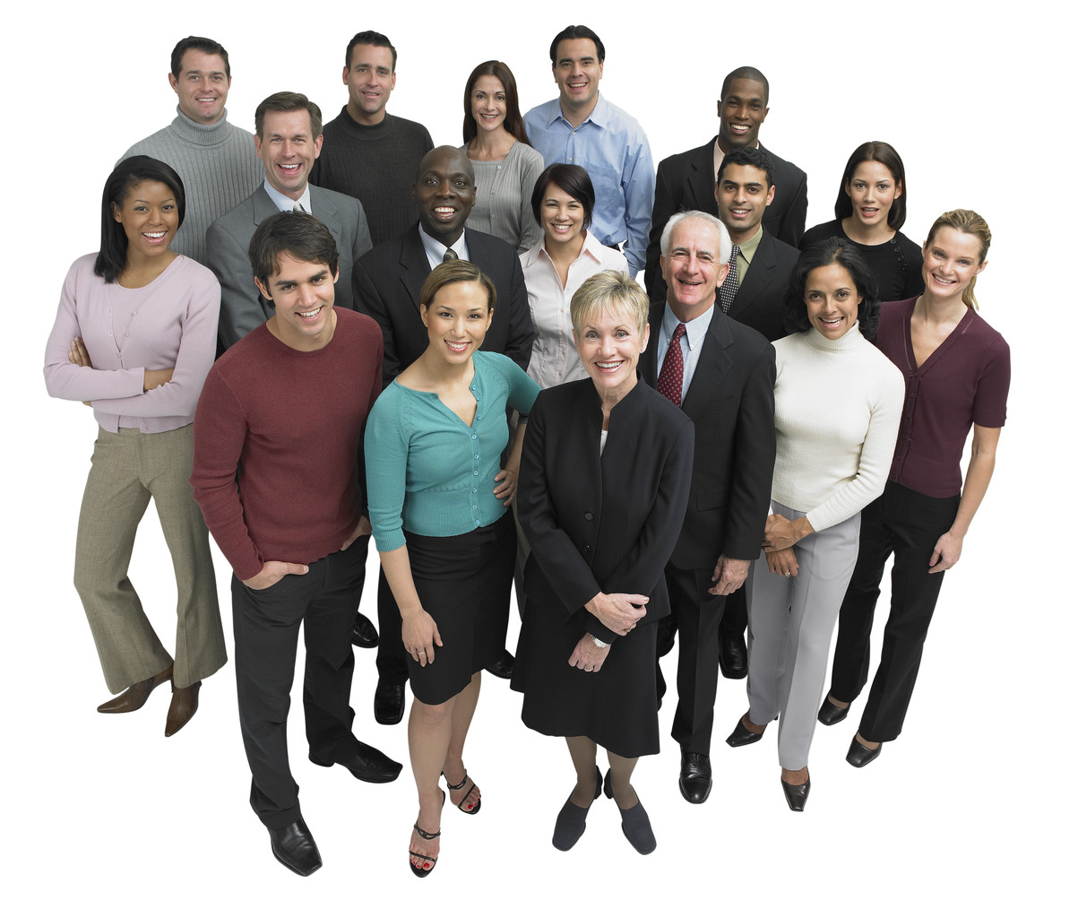
Our Culture
By Deniz, Kris, Davidson, and Jahzun

Slide 2
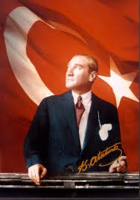
Deniz
Aat
Ataturk was the founder of Turkish Republic
My name is Deniz. My mother’s side of the family comes from Turkey. My father’s side comes from French and Welch. In summer we usually go to Turkey to visit my relatives. Family plays an important role in my life and culture. The most important values in Turkish culture is respect and honesty. In Turkey they speak Turkish, and I can speak Turkish since I went to 1st Grade in Turkey. Good manners are very important in Turkish society and Turkish people are very hospitable. Turkey is a land of rich history and diverse natural beauty. Situated geographically and culturally between East and West, Europe and Asia, Turkey is a country in transition. If you visit Sultanahmet in Istanbul, which used to be the heart of Ottoman Empire, you can see a lot of historical palaces, mosques, churches, etc. Turkish food is delicious. If you like Mediterranean cuisine, you will enjoy Turkish food. The most favorite Turkish foods are skewers of lamb , chicken shish, doner and kofte kebab. My favorite Turkish food is kofte kebab. I like being Turkish-American, that way I have the best of both cultures.

Slide 3
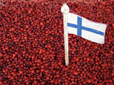
Kris
My name is Kris and I have Finnish heritage. Finns are very modest and they view being humble and modest as virtues. The sauna has a special role in the life of Finns. Finns always expect courteous behavior. Interrupting is rude in Finnish culture. Finns do not like wasting so we finish everything in our plate. I am proud of my Finnish heritage.

Slide 4
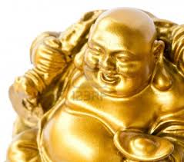
Davidson
My name is Davidson Do, my culture is from China. We pray to the Buddhist gods, like the God of wealth, and we visit the graves of family members who have passed away. One of the most important cultures in China which is famous around the world is food. We eat rice with beef, BBQ chicken, and pork chops with egg on the side.. Chinese dragon is a beneficent creature, the bringer of fertilizing rains. It has been the symbol of emperor. Righteousness, propriety, wisdom and fidelity are important virtues in Chinese culture. Chinese people are hardworking and thrifty.That is what’s good about my culture.

Slide 5
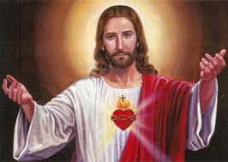
Jazhun
Hello my name is Jazhun Brown. My culture is from Africa. My family and I are Christian, and we believe in Jesus. We pray to Jesus every night before we go to sleep; and on special occasions, we go to cemetery and pray. My family and I have family dinners together every Sunday as a family tradition. We go to church every Sunday, too. African culture includes all the cultures that were ever in Africa. These include music, art, literature and practices of Africa. Well, that’s my family traditions and my culture. I had a great time telling you about my culture.

