Slide 1
My LIFE
BY Darin Whitley
7th period

Slide 2
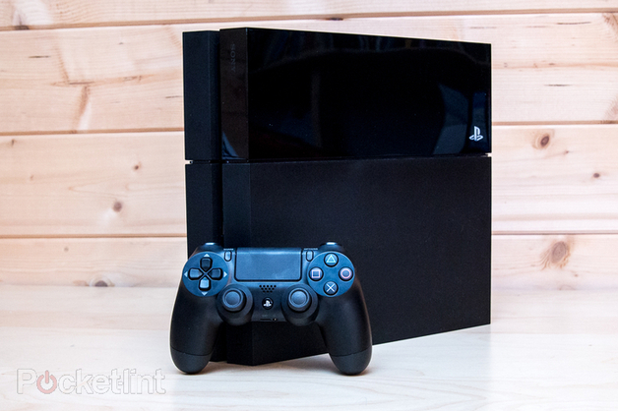
I am from playing video games.

Slide 3
I am playing on my pc.

Slide 4
I am playing Titanfall the new game

Slide 5
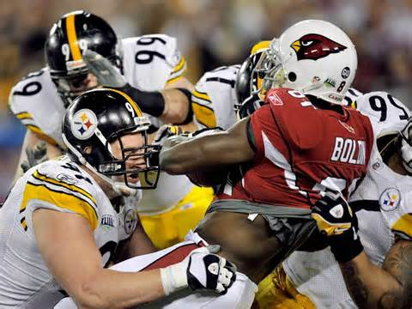
I am from playing football

Slide 6
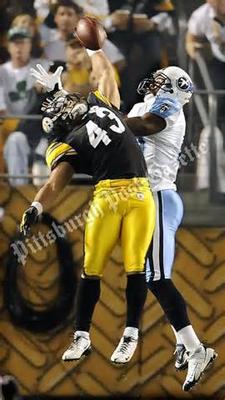
I am from liking my best player

Slide 7
I’m from the storyteller and in a tone of distance regret and the storyteller , I’m from writing stories I’m from Skyah , Burma and british rice and beverage from mary frances marcer was change by cow

