Slide 1
My culture
By: Daniela Monterrosa
Period:7

Slide 2
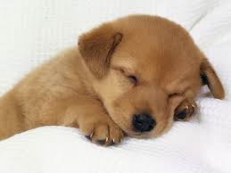
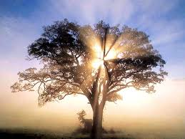
I am from family pictures from a dog and a couch. I am from the warmth and safe. It smells like roses. I am from the catalaya. The oak tree whose long gone limbs I remember as if they were my own.

Slide 3
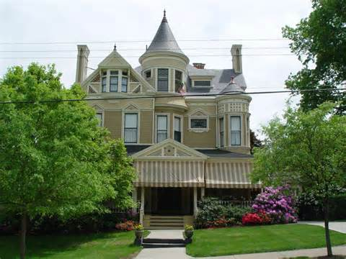
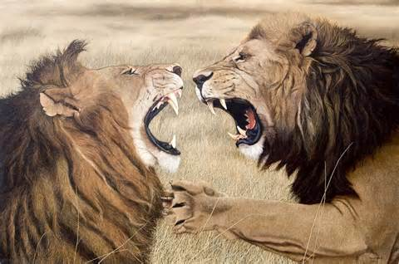
I'm from IPhone and we go to my aunt’s house from Elsie and Daisy. I'm from always fighting and always having barbeques and from always eating together.

Slide 4
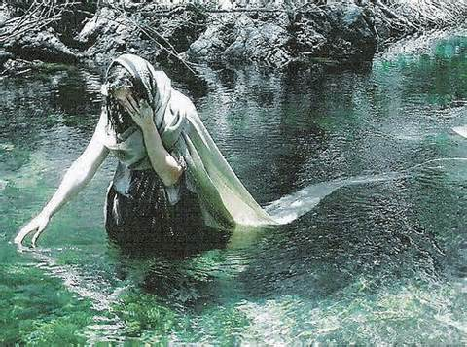
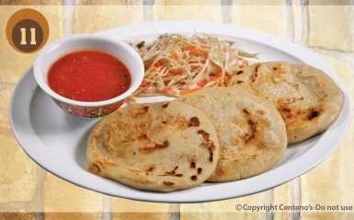
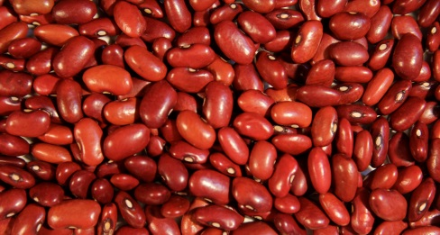
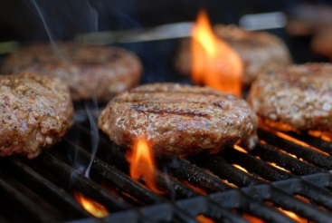
I'm from “la chota” and “ayy mija” and “Vas a Llorar Por Mi”. I'm from eating a lot. I'm from daily city and El Salvador. Pupusas and beans. From la llorona. A lady who killed her own kids. At my aunts house having a barbeque.

Slide 5
Under my blanket.

Slide 6
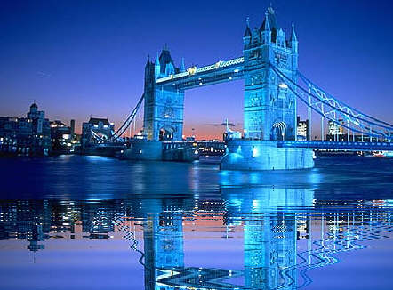
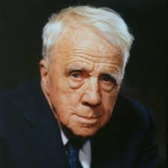
ROBERT FROST
“THE ROAD NOT TAKEN”
I'm from “Two roads diverged in a yellow wood” and “And both that morning equally lay.” Dancing is a vertical of a horizontal desire.” I'm from San Francisco and England. From fried fish sandwiches, to blueberry pie to ice cream, we highlight the must-try options in the region.

