Slide 1
OUR CULTURE
by: Sebastian Dunn, Ben Chan, and Charlie Borreani

Slide 2
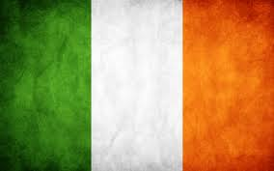
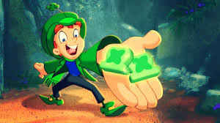
Ireland
St Patrick’s Day is still a big deal in Ireland, but they’re not “required” to wear green.
The capital of Ireland is Dublin
The main language is English, but they used to speak Gaelic
farcoles

Slide 3
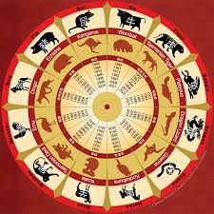
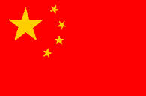
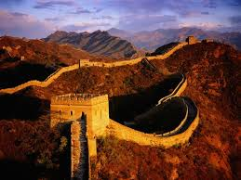
China
The official language is Mandarin, and there are many different dialects
China dates back to 2200 B.C.E.
The capital of China is Beijing
The largest Chinese festival, the Spring Festival, marks the lunar year which is between January and February.
ASDF

Slide 4
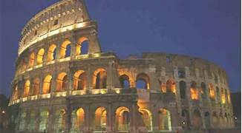
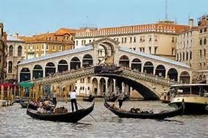
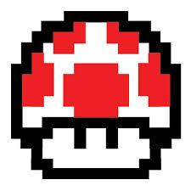
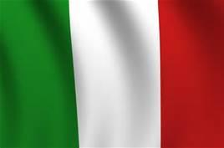
ITALY
Italy is the 5th most populous country in the world
Italy contains 60,891,838 people
Italian is the main language of Italy
The capital of Italy is Rome
The most popular Italian cities are Rome and Venice

Slide 5
Conclusion
We conclude that our culture determines what we interpret because every culture is different and is unique in it’s own way. They have their own traditions and beliefs which influence what we see different things as.

