Slide 1
How do our experiences and/or culture determine what we interpret?
By Anthony Lin and Maxwell Mueller

Slide 2
Chinese culture/experience
I, Anthony Lin, am Chinese.
I grew up listening to Chinese tales that are totally different than the ones here.
Also, the music I listened to were Chinese pop and rock.
I learned English at age 5, so I am slightly behind in that area.
Video games i played includes the Playstation 2, Playstation 3, and the Gamecube.
Because of how I was taught, I may think differently than my friends. Like when I see squid, I may think of takoyaki, a Japanese treat, while others might think of it as calamari. I’m usually a bit nonchalant, so i don’t take things too seriously.

Slide 3
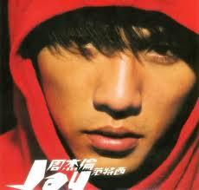
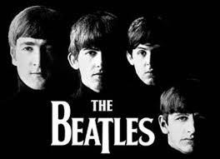
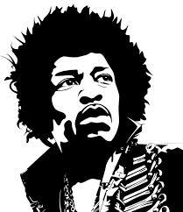
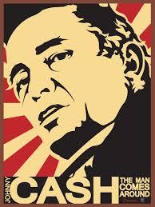
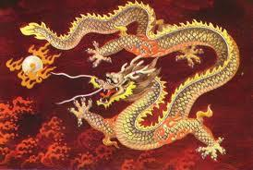
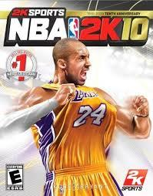
Music and Entertainment (Anthony’s)

Slide 4
America culture/experience
I’m Maxwell Mueller and I’m from America.
I grew up listening to classic rock, dubstep,and playing the oboe and guitar.
I played the Nintendo Gamecube, Wii, and the Xbox 360
I watched animal planet and Spongebob
Because of the way I was raised and how many games I play, I see things in a playful and fun way.

Slide 5
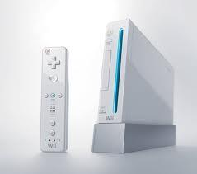
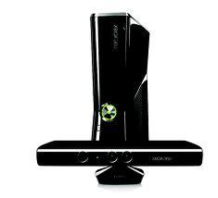
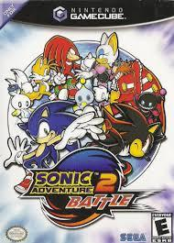
Music and Entertainment (Max’s)

