Slide 1
MY Life story
Annette Mejia
Period 7

Slide 2
I Was Born In Berkeley were my dad showed me to the whole hospital

Slide 3
I’m from a silly family and loud from Guille & Mike .
I’m from talking on the phone and drinking hot chocolate and from going on adventures.

Slide 4
“ Knowing my family so well I can tell who’s coming down the stairs by the sound of their footsteps.”

Slide 5
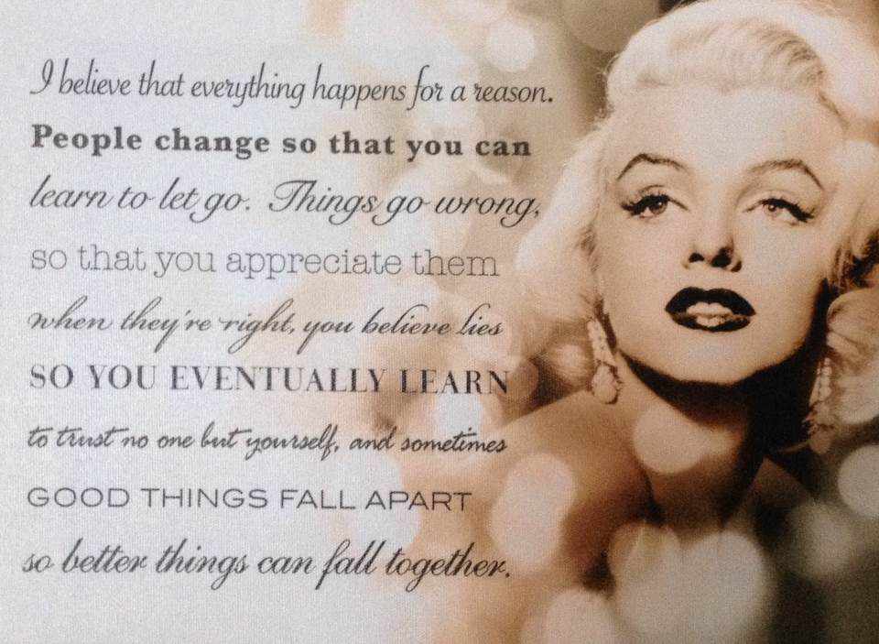
Every day I wake up reading this

Slide 6
Meet my four silly puppies
“My Goal In Life Is To Become As Wonderful As My Puppies Thinks I Am “

Slide 7
My older Brother
I Am Smiling Because You Are MY Brother. I Am Laughing Because There IS Nothing You Can Do About it!

Slide 8
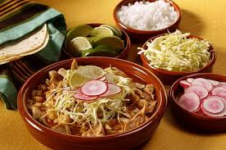
What we eat for family accession

Slide 9
I’m from eating pozole with my family every christmas

Slide 10
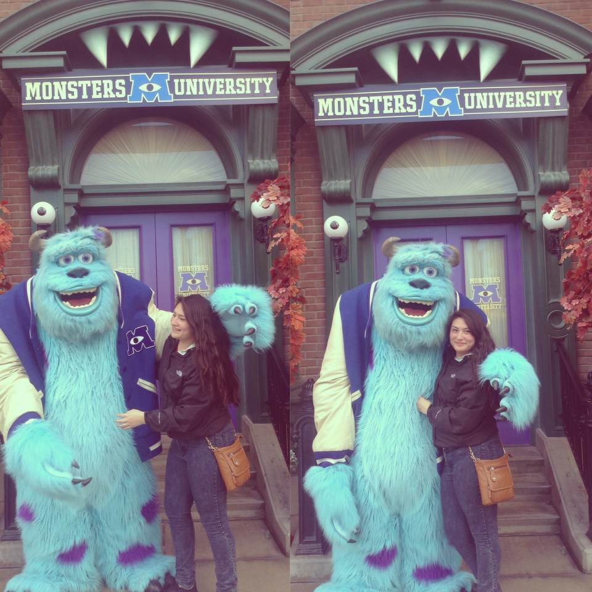
My family first trip was to disneyland

