Slide 1
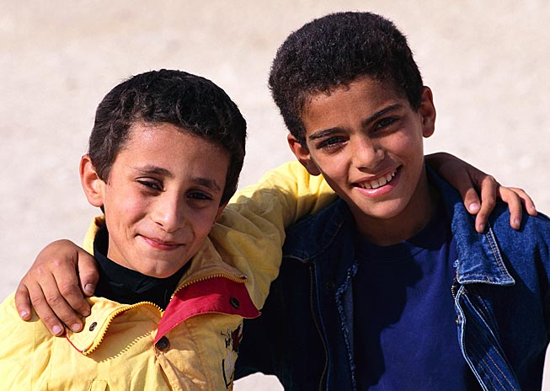
Amigo Brothers by Piri Thomas
They had known each other since childhood . . .

Slide 2
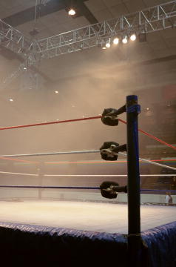
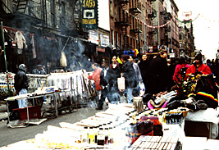
Amigo Brothers Background
This story is about two friends (amigos in Spanish) living on the Lower East Side of New York City.
Many youth from the Lower East Side have turned to boxing with the dream of building a better life.

Slide 3
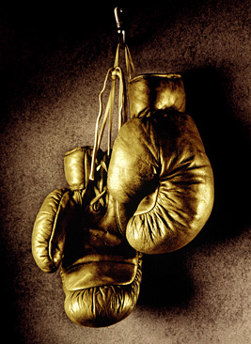
Amigo Brothers Background
Many of these individuals train for the New York Golden Gloves, a tournament started in 1927 by Paul Gallico, a newspaper writer.
Today, the Golden Gloves program spans the country, serving athletes between the ages of eight and thirty-five. The National Golden Gloves Champion often enters the world of professional boxing.

Slide 4
Amigo Brothers by Piri Thomas
Felix and Antonio have been informed that they will fight each other in the division boxing finals. The winner will go to the Golden Gloves Championship Tournament.
Who will win?
Could they both lose?
Can their friendship stand the test?
[End of Section]

Slide 5
Amigo Brothers Literary Focus: Internal and External Conflict
An internal conflict, such as making a decision or facing a fear, occurs within a character’s mind.
The main characters in “Amigo Brothers” also face an internal conflict. As you read, try to figure out what two forces oppose each other in their internal conflict.
How has coping with this internal conflict defined each character?

Slide 6
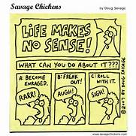
Defining Coping
…anything people do to adjust to the challenges and demands of stress…
….any adjustments made to reduce the negative impact of stress (Red Cross: Community-based Psychological Support, p. 87)
Notes:
Here are two definitions of coping. READ SLIDE
According to Folkman & Lazarus, managing stress includes accepting, tolerating, avoiding, or minimizing the stressor as well as mastery over the environment. Coping, then, is all purposeful attempts to manage stress regardless of effectiveness (Compas, Malcarne, & Fondacaro, 1988).
The second definition is offered by the Red Cross.
Folkman & Lazarus, 1984. Stress, Appraisal, and Coping. Chapter Six, pg. 141.

Slide 7
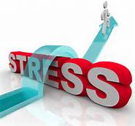
Conceptualizing Coping Strategies
Biological/physiological – fight or flight
Cognitive – how we think about the situation
Behavioral – behavior related to mental process
Learned – strategies learned from modeling/observation
Intentioned – voluntary/involuntary
Notes:
We can conceptualize coping strategies in multiple ways. READ SLIDE
Biological/physiological Coping: The body has a natural method of coping with stress. Any threat or challenge perceived by an individual in the environment triggers a physiological chain of events. The sympathetic/adrenal system secretes epinephrine and norepinephrine. This is the “fight or flight” response.
More often, when we talk about stress and coping we think about the cognitive, behavioral, and learned components.
The cognitive component of coping refers to the mental process and how the individual thinks about the situation. How they think about it then leads to behavior. We’ll talk more about this aspect when we discuss the transactional model of coping.
The learned component of coping includes everything from social learning theories, which assume that much of human motivation and behavior is the result of learning. This includes cultural preferences for coping.
Intentioned: Intentionality refers to whether the strategy is voluntary or involuntary; thoughtful and intentional or automatic.
A number of models of coping have been developed. Next, we’re going to explore four models of coping: The Transactional model, the Responses to Stress model, the Motivational model, and the Community Stress Prevention model.

Slide 8
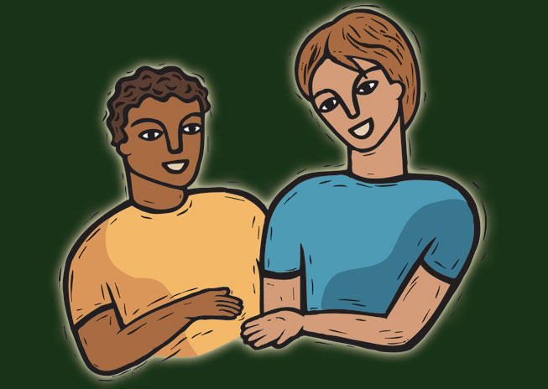
Amigo Brothers by Piri Thomas
Try to keep in mind:
The Internal Conflict that each character is going through.
How they cope with that stress?
What each characters’ actions, words and/or description tells the reader about their personality?
What adjectives define them?
Be sure to connect how their type of coping has told the reader what type of person they are.

