Slide 1
A Christmas Carol
Lesson 1: Introduction

Slide 2
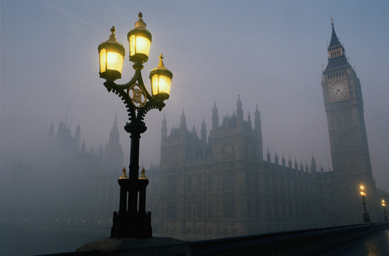
A Christmas Carol: Introduction
On a cold and foggy Christmas Eve sometime in the middle 1800s, Ebenezer Scrooge sits working in his office in London.
He is visited and surrounded by people who help the reader understand Scrooge’s cool, indifferent character.

Slide 3
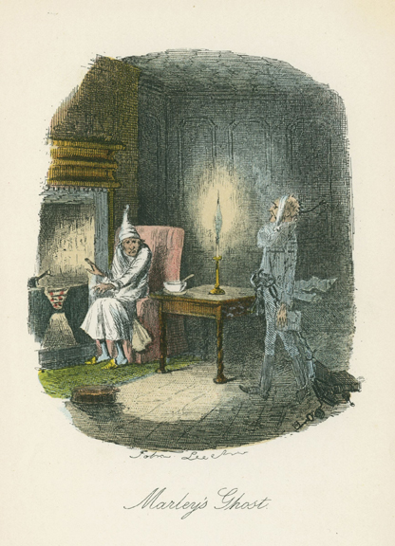
A Christmas Carol: Introduction
One by one, four ghosts appear to Scrooge.
They’ve come to try to convince him to become a nicer person.

Slide 4
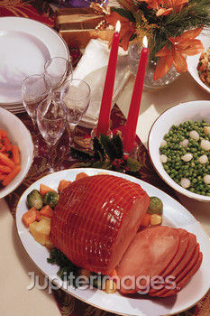
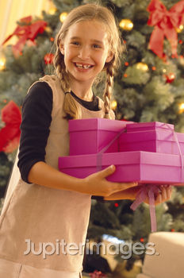
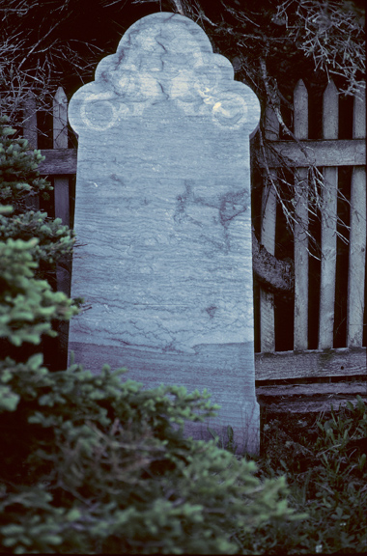
A Christmas Carol: Introduction
The ghosts will show Scrooge
the past he is forgetting,
the present he is missing,
and the future he is
shaping.
But will their revelations get through to Scrooge? Will he change his `ways?

Slide 5
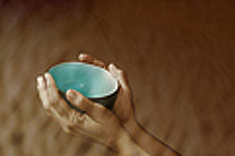
A Christmas Carol: Background
In Victorian England, poor people usually did not get much help.
Even young children, sick people, and the elderly went without assistance from the government or charities.

Slide 6
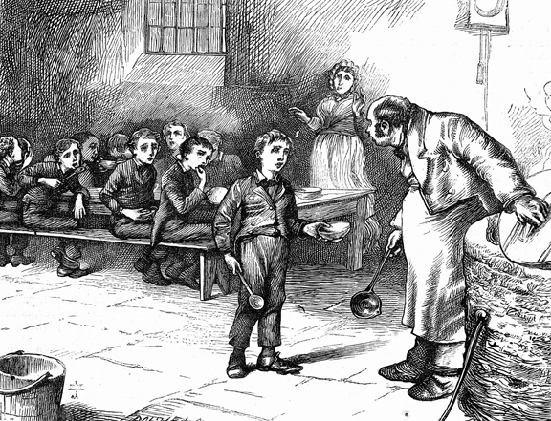
A Christmas Carol: Background
If you were a poor, out-of-work Londoner during this time, these were your options:
beg on the street
go to a workhouse
be thrown into prison

Slide 7
Pay Attention as You Read to:
Scrooge believed that human beings were largely responsible for society’s ills, such as poverty. What other social problems do you think he would have seen as being “their own fault”?
How does Scrooge act towards people in his life? What does that say about his beliefs and the type of character he is?
It takes time to change. Little things happen, one by one, that alters the way we feel or think about something. What little things start to bother Scrooge and alter is attitude?

Slide 8

Characterization
Choose one of the following emotions, and write a description to embody the emotion as a person.
If LOVE were a person, what would he/she look like?
ANGER
PEACE
If GREED were a person, what would he/she look like?
If RAGE were a person, what would he/she look like?
JEALOUSY
HAPPINESS
CALM
STRESS
CHARITY
HONESTY
Be sure to include:
Facial expressions and features, body shape and size, clothing, posture, body language and gestures.

Slide 9
Let’s read! Page
Please follow along
Pay close attention to how Scrooge is described.

Slide 10
How is Scrooge described?
Looking back at the section of the text in which Scrooge is described, what sort of words are used? Let’s compile a class list here:

Slide 11
Task
Using the words used to describe Scrooge, and what we know of him from our reading so far, sketch an image of Scrooge in your workbooks.
Label him with the features described by Dickens.

Slide 12
Characterization
Last lesson we discussed how ‘Scrooge’ has now become linked with grumpiness and a dislike for Christmas. Therefore it can be said he personifies these type of characteristics.
How does Dickens effectively show us that Scrooge is a grumpy old miser in his description alone?

Slide 13
Looking into the Character
What is Scrooge’s attitude towards Christmas?
How can his attitude be linked to Victorian attitudes at the time?

Slide 14
A Christmas Carol
Lesson 3: Grammar Point-Active vs. Passive Voice

Slide 15
Voice
Voice is the form a verb takes to indicate whether the subject of the verb performs or receives the action.
There are two types of voice: active voice and passive voice.

Slide 16
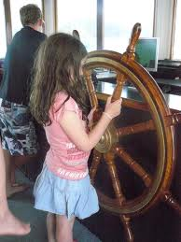
Active Voice
Active voice verbs are used when the subject is acting in a sentence.
Example:
  Cindy steered the boat.
“Steered” is an active verb because it allows the subject to undertake an action.

Slide 17
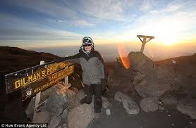
Passive Voice
“Passive voice” verbs are used when the subject is being acted upon in a sentence.
Example:
  The mountain’s peak was reached by Ed Danvers.
“Was reached” are considered passive because they indicate that the subject (peak) is receiving an action.

Slide 18
So What?
Although both constructions are grammatically correct, the active voice is usually more effective in academic and business writing because it is simpler and more direct. The passive voice is effective only when the doer of the action is unknown or irrelevant.
  Examples
  The cruise liner was hijacked.
  The ball was hit.
  The town was quarantined.

Slide 19
Form of Passive Voice Verbs
Note the forms of "to be" in the examples of the verb "to kick" in various forms of the passive voice:
is kicked----------------had been kicked
was kicked-------------is going to be kicked
is being kicked---------will be kicked
has been kicked-------can be kicked
was being kicked------should be kicked
THE ACTIVE VOICE DOES NOT USE THE VERB TO BE WITH ANOTHER VERB

Slide 20
Example:
  The government built a road right outside her front door.
  A road was built right outside her front door.
  The statue is being visited by hundreds of tourists every year.
Hundreds of tourists visit the statue every year.

Slide 21
Example:
  The government built a road right outside her front door.
  A road was built right outside her front door.
  * Notice that the “doer” has become
  irrelevant/unimportant.
  Hundreds of tourists visit the statue every year.
  The statue is being visited by hundreds of tourists every year.

Slide 22
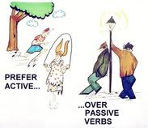
Review
Active voice verbs: Verbs that indicate the sentence’s subject as actively acting:
  Marvin hit the ball.
Passive voice verbs: Verbs that indicated the sentence’s subject as being acted upon:
  The ball was hit by Marvin

Slide 23
Let’s Practice
Directions: Identify the voice, then change the sentences below to the active/passive voice.
  Mr. Ross broke the antique vase as he walked through the store.
  These books had been left in the classroom by a careless student.
  The construction workers are making street repairs all month long.
  The house had been broken into by someone while the owners were on vacation.
  My books were stolen by someone yesterday.
  Coffee is raised in many parts of Hawaii by plantation workers.

Slide 24
Check out:
ENGLISH PAGE - Active / Passive Verb Forms
For verb forms.

Slide 25
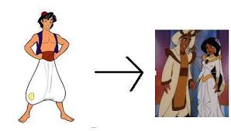
A Christmas Carol
Dynamic vs. Static Characters
Lesson 2: Dynamic Characters

Slide 26
Change
Specific type of change
  Internal
    Major change in personality
    Change in character’s outlook on life
    Values
    Overall change in nature of character
Within, not to the character

Slide 27

Is there change?
Ask yourself
  Have the character’s personality/values/outlook changed throughout the story?
Yes
  Dynamic
No
  Static

Slide 28
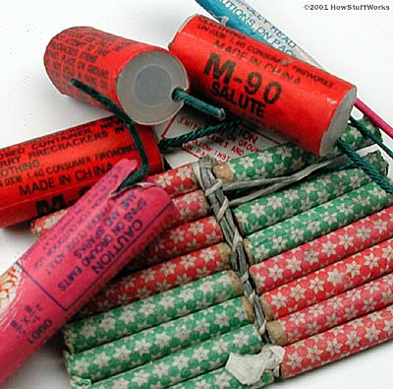

Dynamic/Round
Major change in character
Bad → Good
Good → Bad
Crucial to the story

Slide 29

Static/Flat
Remains same throughout story
Same beginning to end
  Mean
  Nice
No internal changes
Example:
  Plastic surgery

Slide 30
Dynamic Characters
Harry Potter
    Beginning: timid and nervous; unsure of his abilities
    End: powerful and confident leader
Grinch
    Beginning: mean, bitter, greedy
    End: generous, kind, beloved

Slide 31
Static Characters
Cinderella’s stepmother
  Beginning: bitter, cruel, cold
  End: bitter, cruel, cold
Cinderella
  Beginning: generous, loyal, honest
  End: generous, loyal, honest

Slide 32
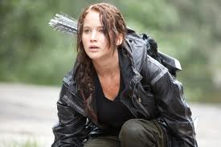
Katniss: Dynamic or Static?
DYNAMIC
Beginning: scared, gallant & self-sacrificing= entered the Hunger Games to save her sister.
End: defiant= By being inside the Games she developed the will to rebel against the Capitol.

Slide 33
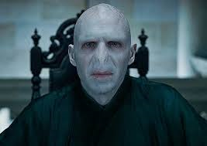
Lord Voldemort: Dynamic or Static?
Static
Beginning: evil
End: evil

Slide 34
http://www.youtube.com/watch?v=azUsjQwF_UI http://www.youtube.com/watch?v=XjVlyIvLg3Q

