Slide 1
2nd Week of Novel

Slide 2
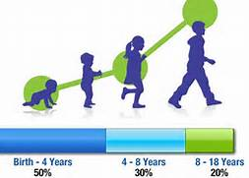
What is a bildungsroman?
-Definition: a novel depicting someone's growth from childhood to maturity
-The protagonist grows, learns, and changes in order to take his or her place in the world
-Bildungsroman is a German word that literally means “a novel of formation”
-It is sometimes referred to as a coming of age story

Slide 3
Closing Questions:
What changes do you see in Esperanza?
Does she see the changes in herself?
Do others/outsiders see the changes in her?
How does it seem she feels about these changes?
How do these changes relate to Esperanza’s identity?
Is she starting to find one?

Slide 4
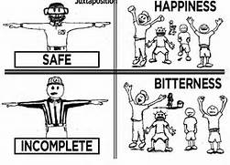
What is juxtaposition?
-Definition: the arrangement of two or more ideas, characters, actions, settings, phrases, or words side-by-side or in similar narrative moments
-Used for the purpose of comparison, contrast, rhetorical effect, suspense, or character development

Slide 5
Your Childhood- Write on a piece of paper.
How old were you?
Where were you?
What were you doing?
Why did you feel this way?
Did you ‘leave someone behind’?
Were you ever the one ‘left behind’ by an older someone else growing up?

